Slide 1
Integrating Genomic Data: LD and SNP-based annotation
HUGEN 2073
Genomic Data Visualization and Integration
Jon Chernus

Slide 2
Last time
Why annotate?
Linkage disequilibrium
Overview of some tools/databases
Introductory examples
FUMA output
Successes, e.g., in the IRX3/IRX5 BMI “story”
Limitations/caveats

Slide 3
This lecture
More detailed walkthrough for querying LD information and SNP-level annotation
LDlink
VEP
HaploReg
RegulomeDB
GWASCatalog
Using R packages to access these data

Slide 4
Possible “workflow”
Tools
LDLink
HaploReg
FUMA
(more)
Tools
LDLink
VEP
HaploReg
RegulomeDB
(more)
GWAS results
(top hits)
GWAS associations + LD “friends”
Annotation
Note that these tools have some overlapping functions and some unique functions
The output from one tool may be the input into another (or the input for a different function of the same tool)

Slide 5
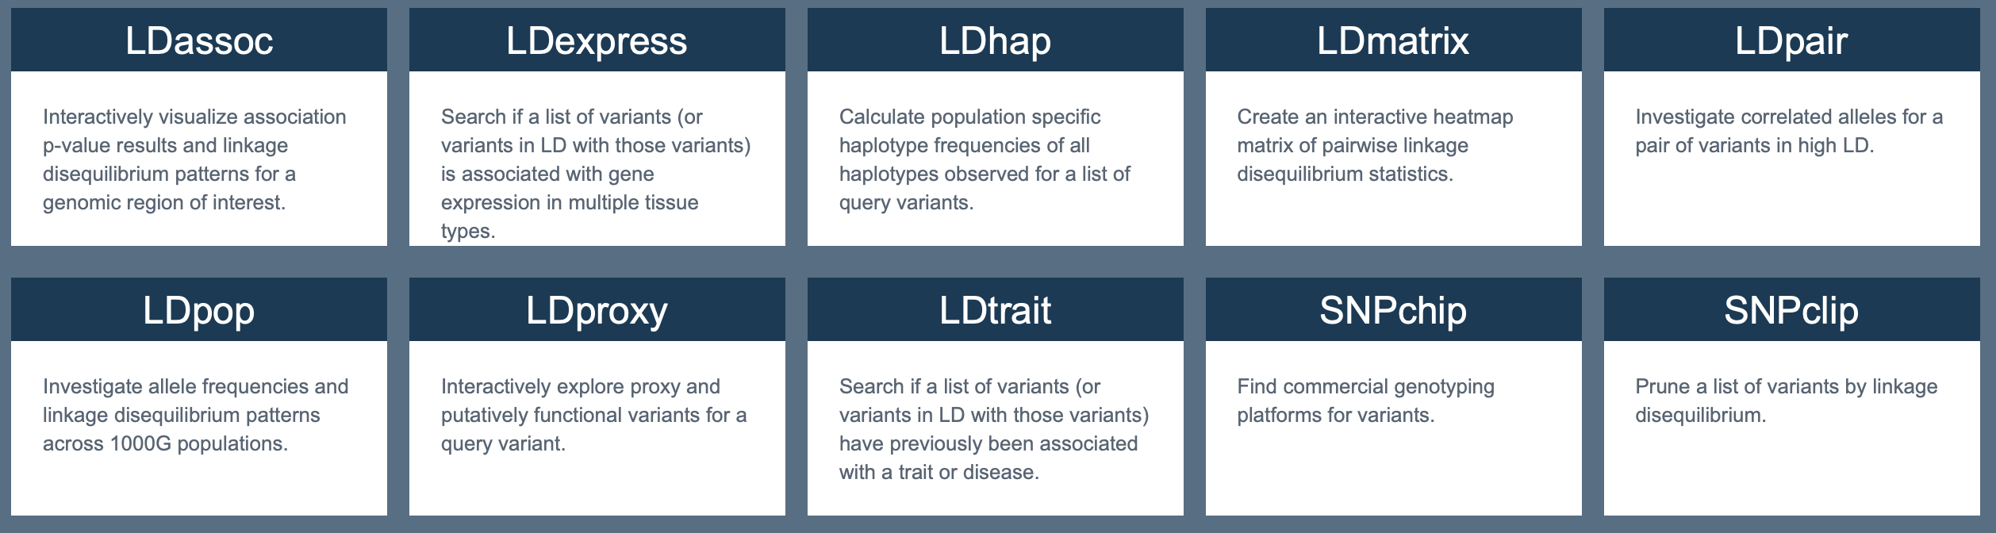
LDlink
https://ldlink.nci.nih.gov/?tab=home
LDlink is suite of web-based tools for looking up and visualizing LD information, using dbSNP, 1000Genomes, GTEx data (and more)
There is an R package API, LDlinkR, which you’ll try out.

Slide 6
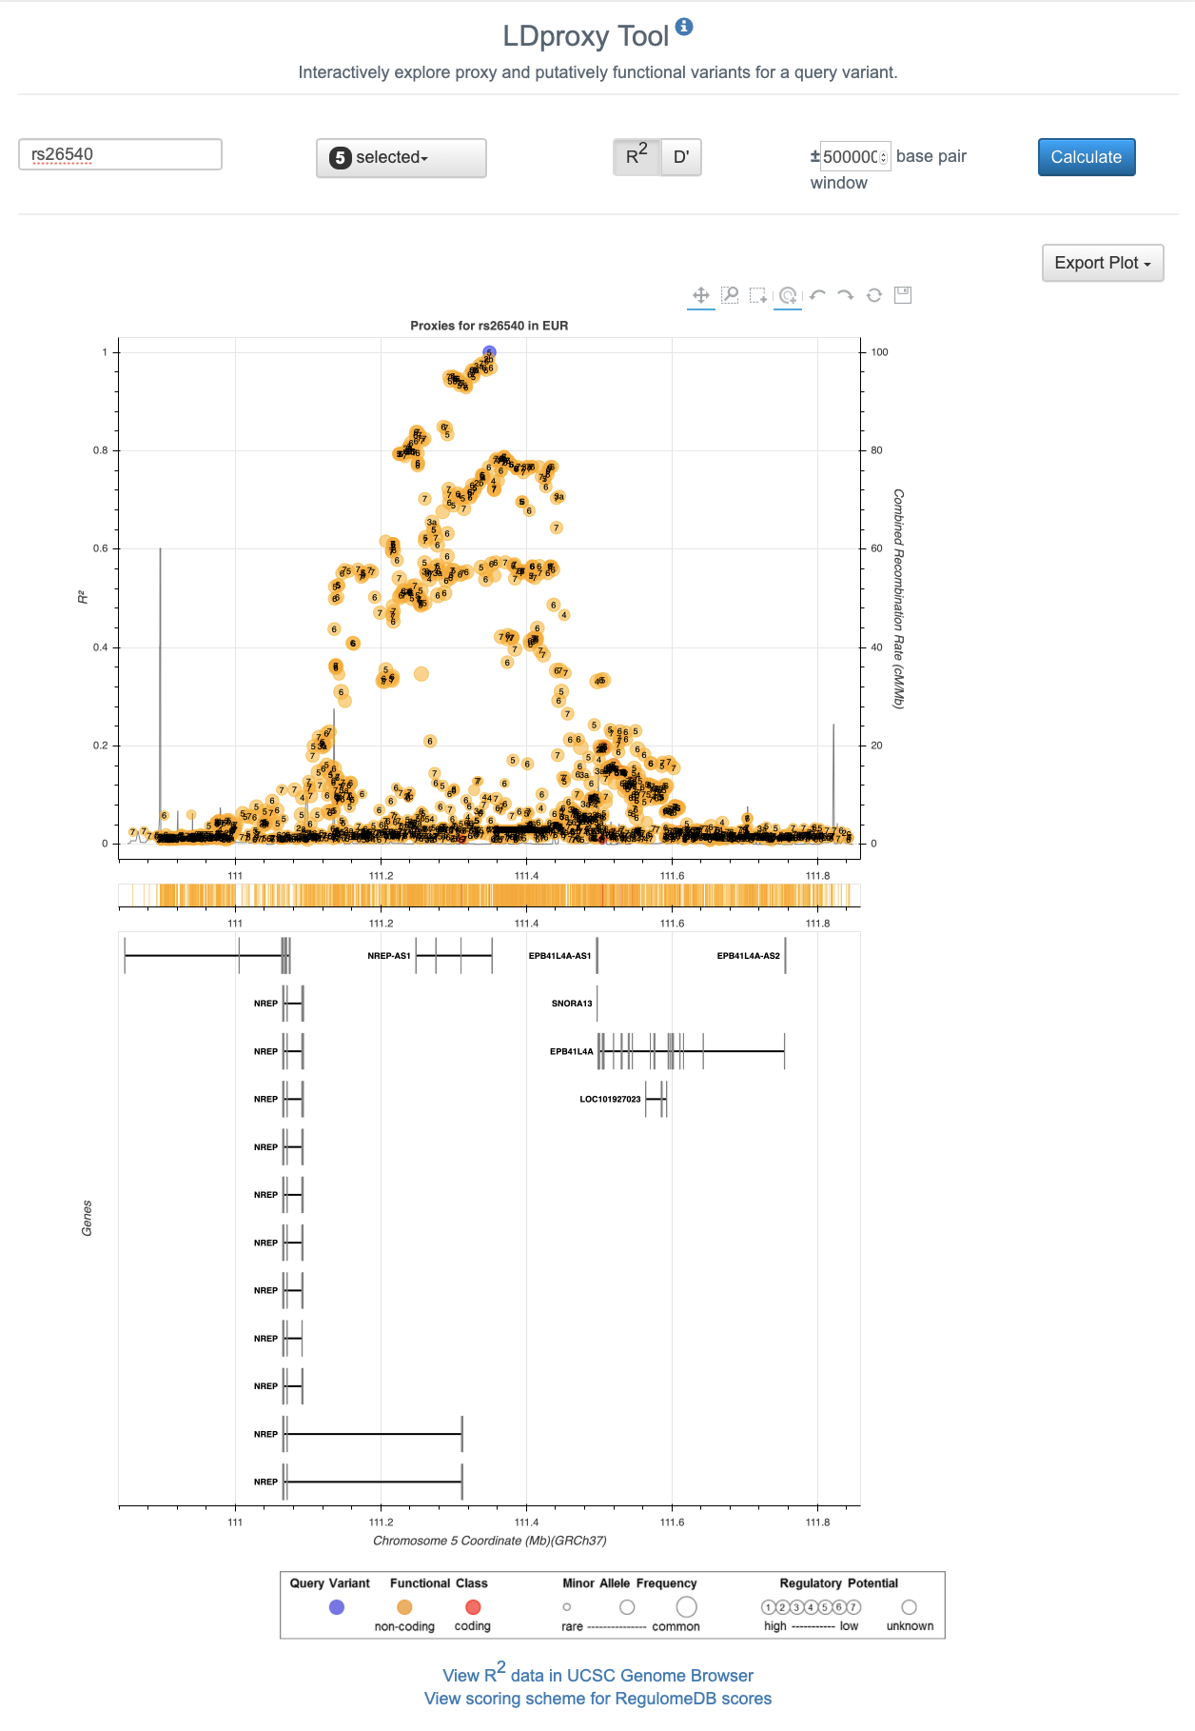
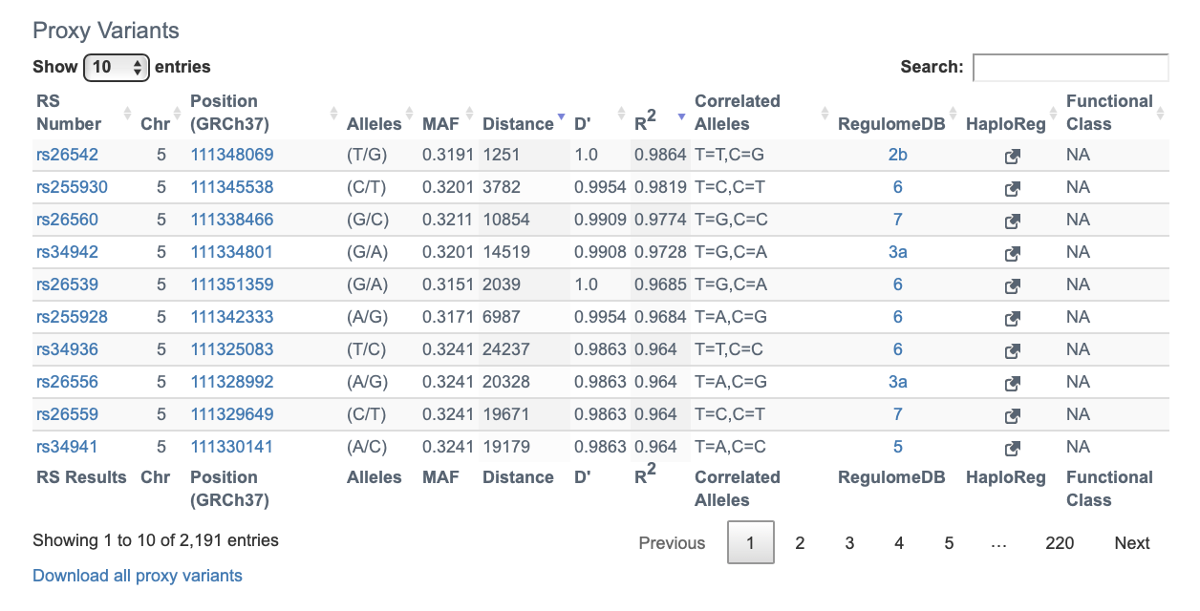
LDProxy
Input: SNP (and populations)
Output: Downloadable list of SNPs in LD with annotation and plot
Notes:
rs26542
rs255930
rs26560 rs34942 rs26539
rs255928
rs34936
rs34941

Slide 7
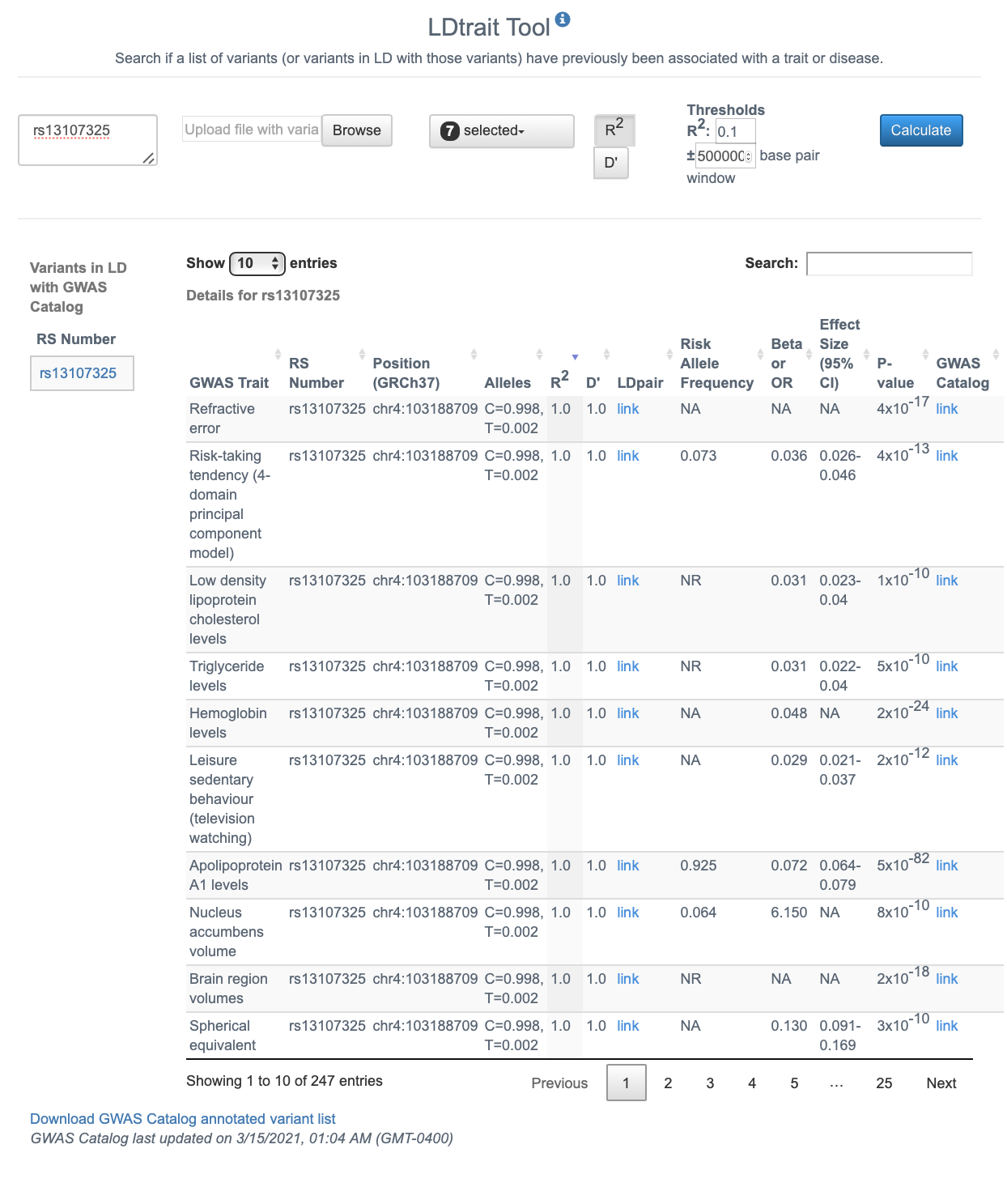
LDtrait
Input: SNPs of interest
Output: GWAS associations for the input SNPs and their LD ”friends”

Slide 8
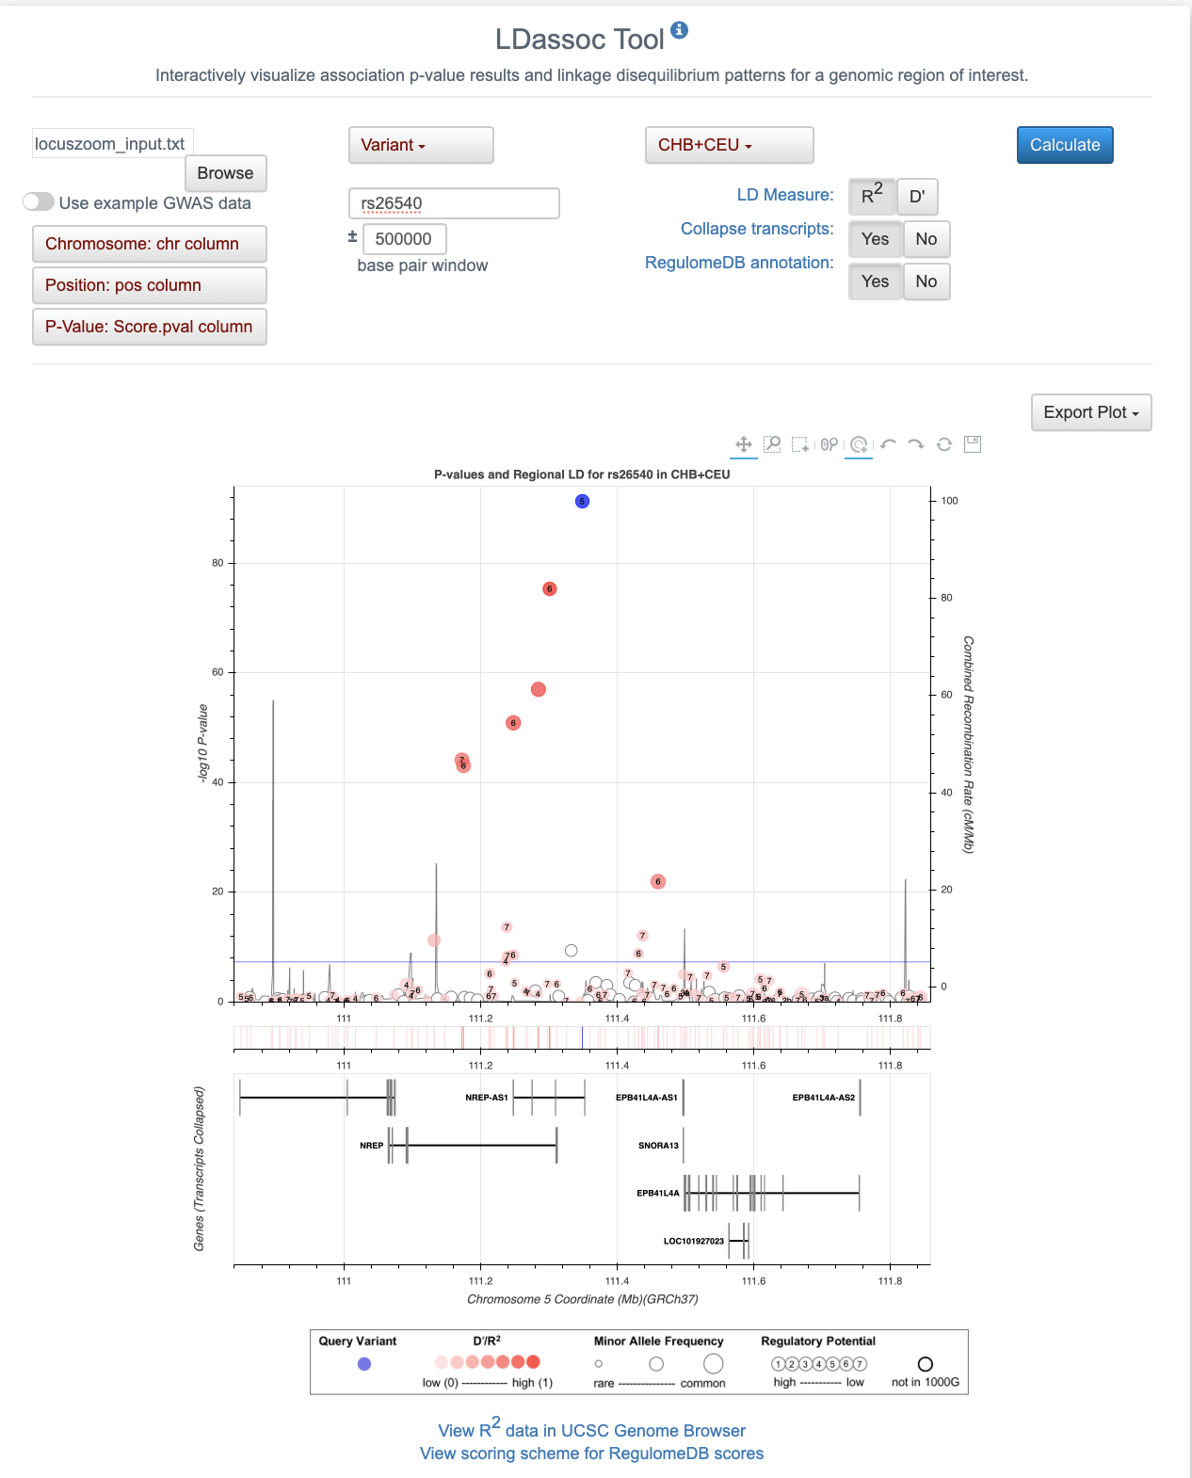
LDlink > LDassoc
Input: GWAS results (select region/population)
Output: Interactive LocusZoom plot with LD and allele frequency annotation

Slide 9
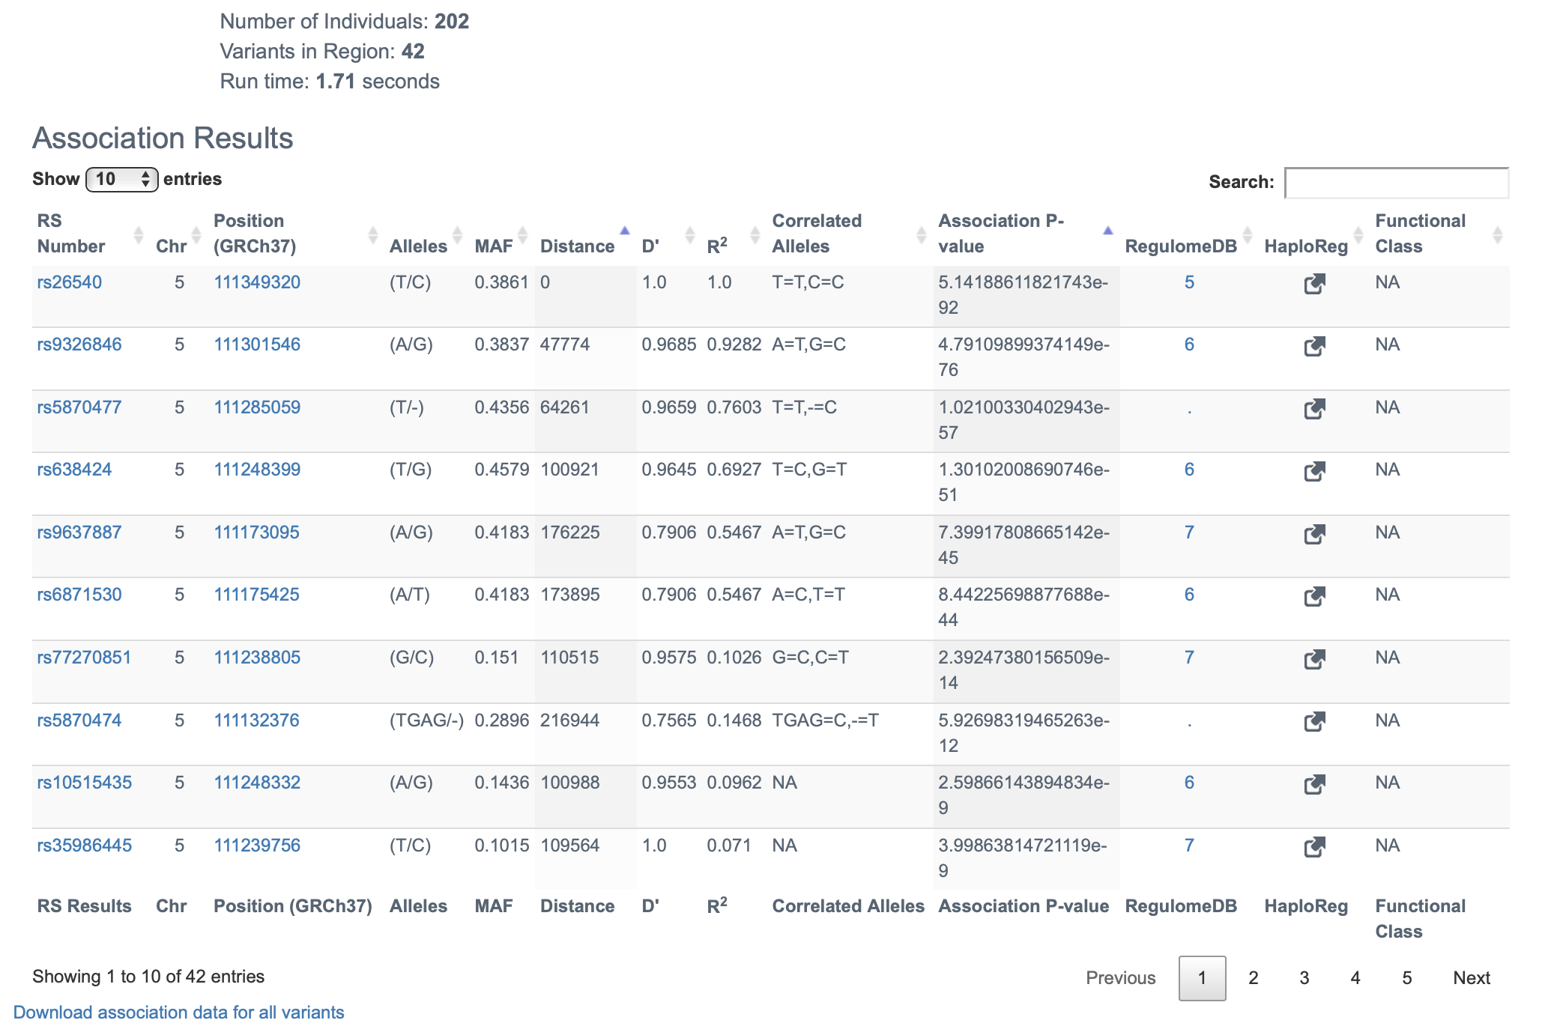
LDlink > LDassoc (con’t.)
Input: GWAS results (select region/population)
Output: Interactive LocusZoom plot with LD and allele frequency annotation (with downloadable table)

Slide 10
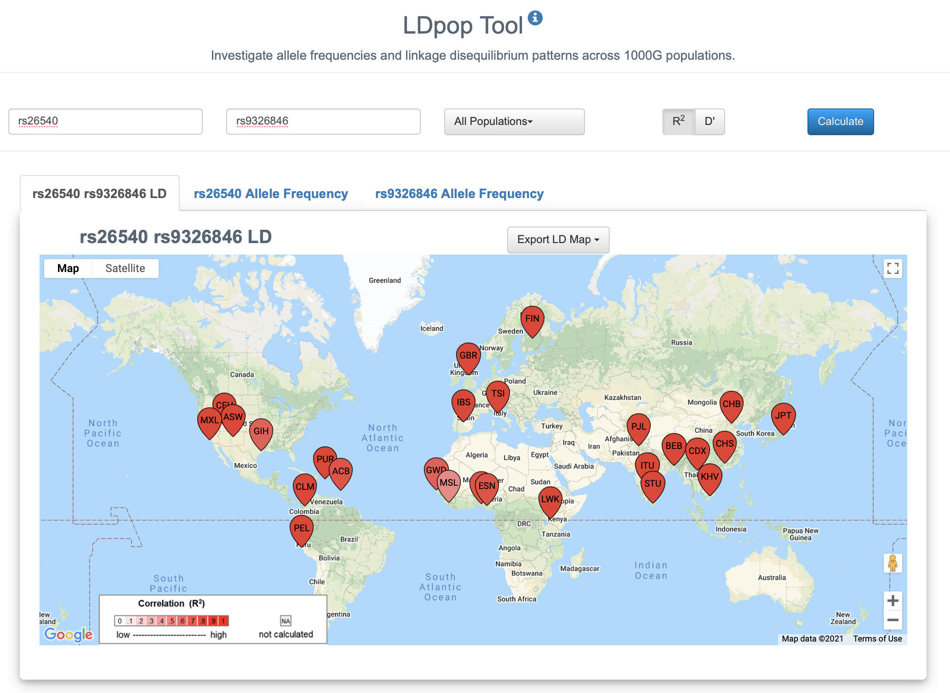
LDlink > LDpop & LDPair
Input: two SNPs
Output: LD and allele frequency data for selected populations

Slide 11
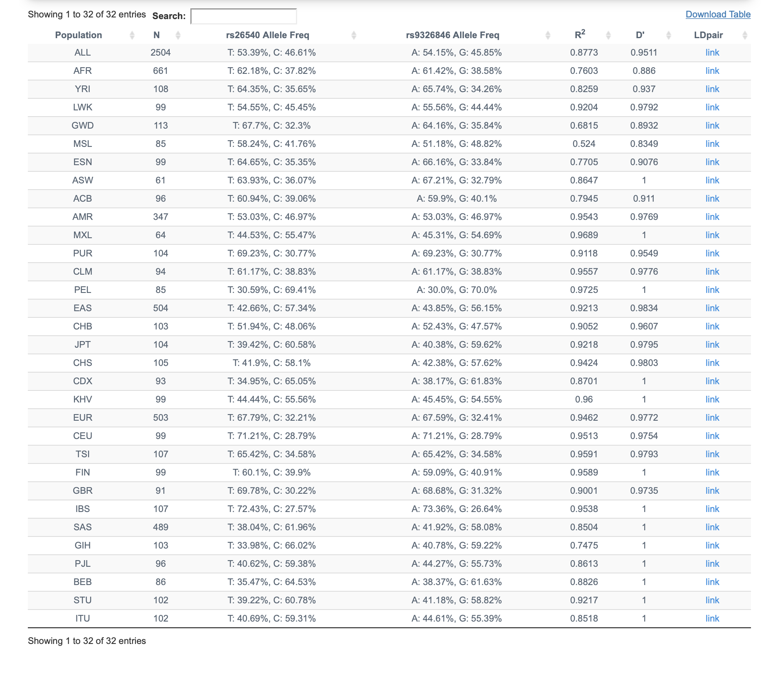
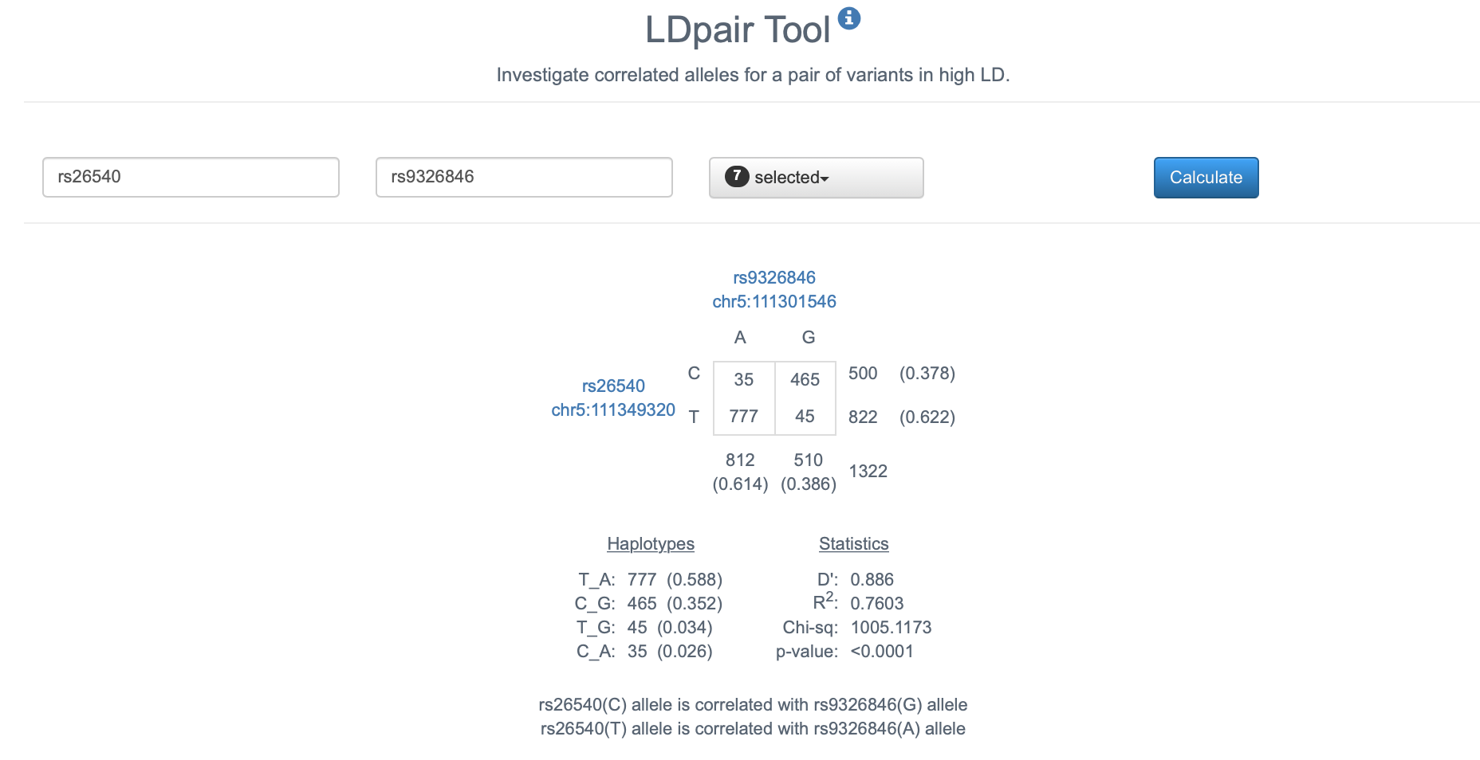
LDlink > LDpop & LDPair

Slide 12
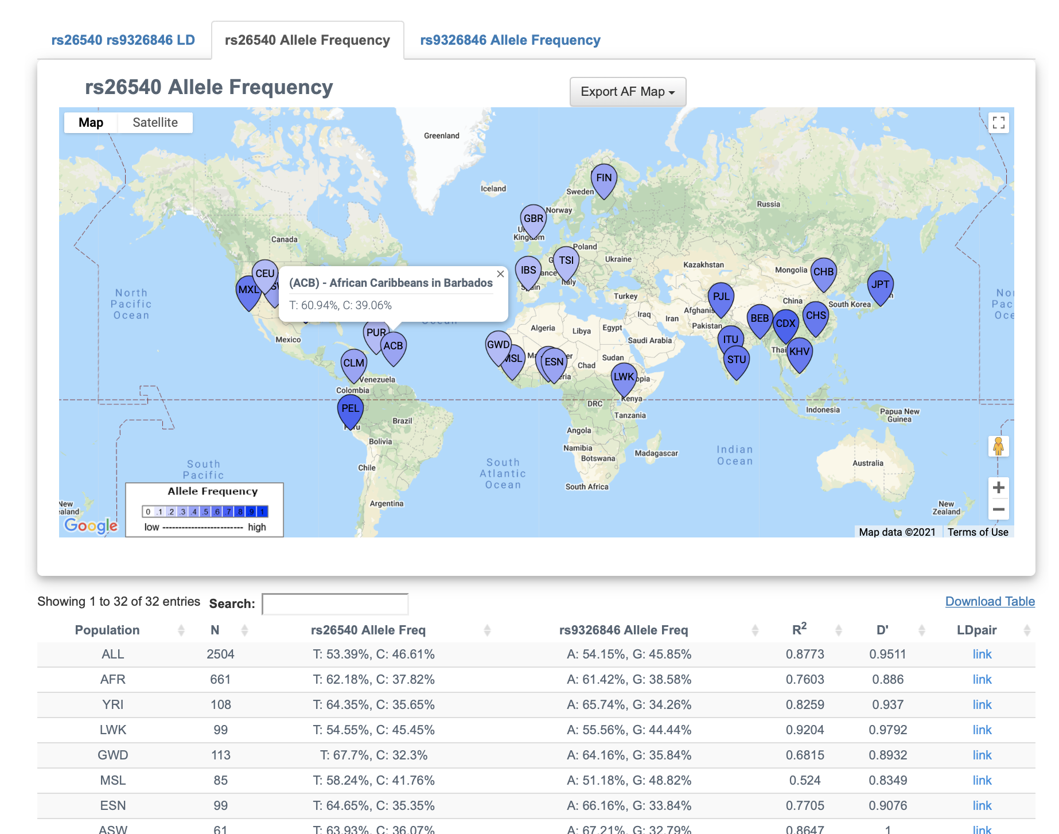
LDlink > LDpop & LDPair

Slide 13
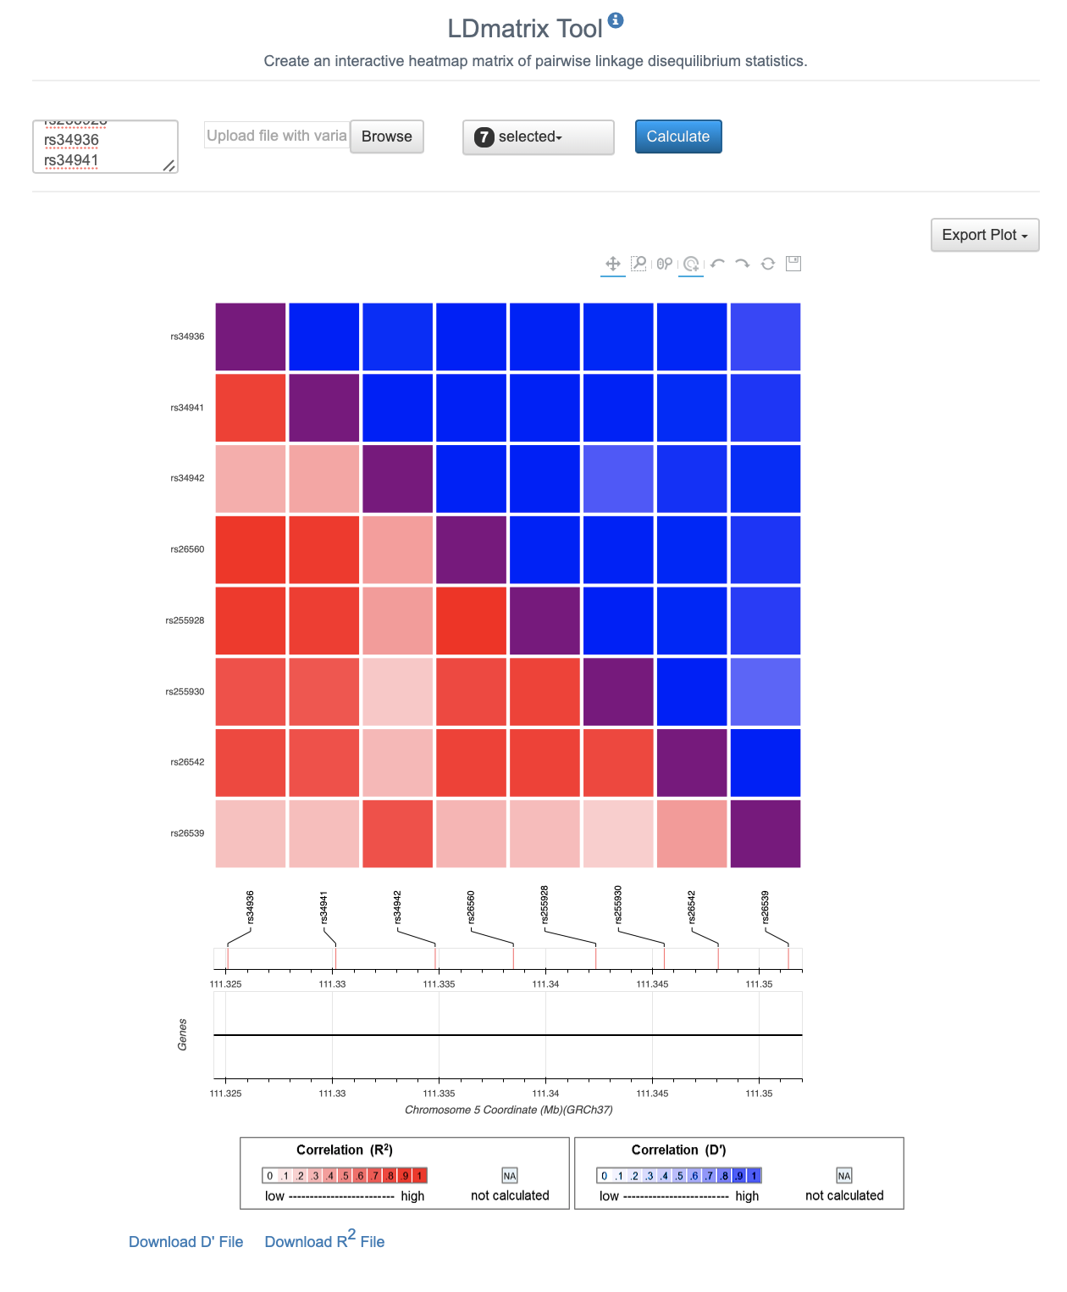
LDlink > LDMatrix
Input: list of SNPs
Output: Correlation heatmap

Slide 14
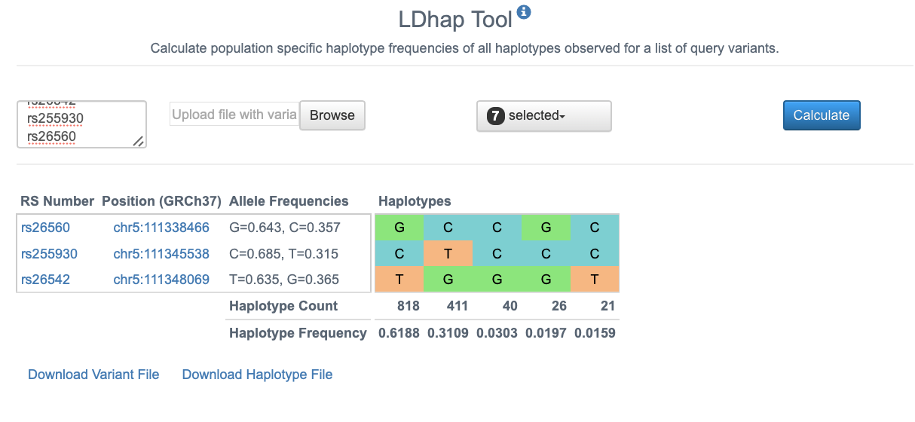
LDlink > LDhap
Input: list of SNPs
Output: haplotype frequencies in specified population

Slide 15
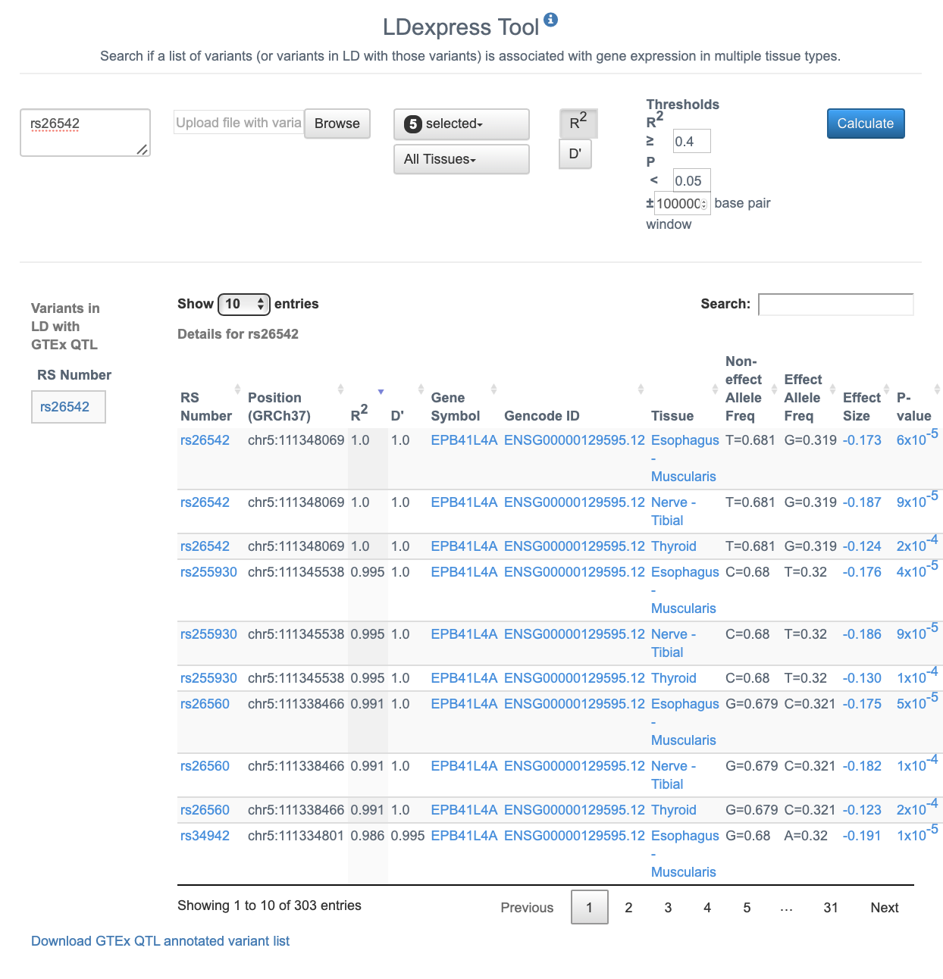
LDlink > LDexpress
Inputs: SNPs window size selected tissues eQTL p-value LD constraints (pop, R²)
Output: eQTL associations

Slide 16
VEP
Also available as a command-line tool:
https://useast.ensembl.org/info/docs/tools/vep/script/index.html

Slide 17
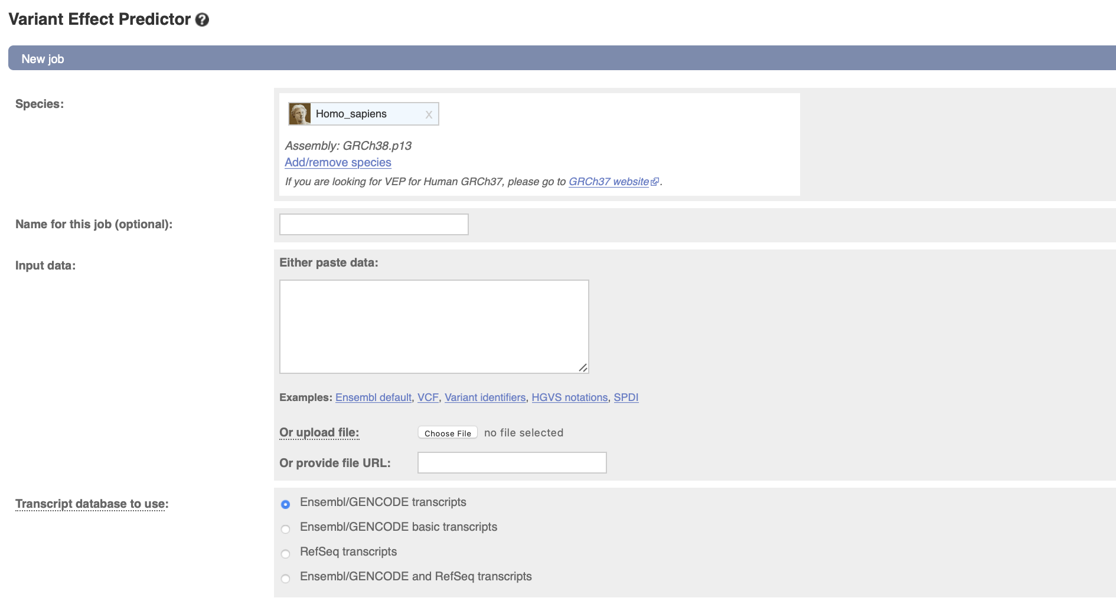
VEP (Variant Effect Predictor)
Required input: List of variants (either paste text or supply a file) Your choice of transcript database

Slide 18
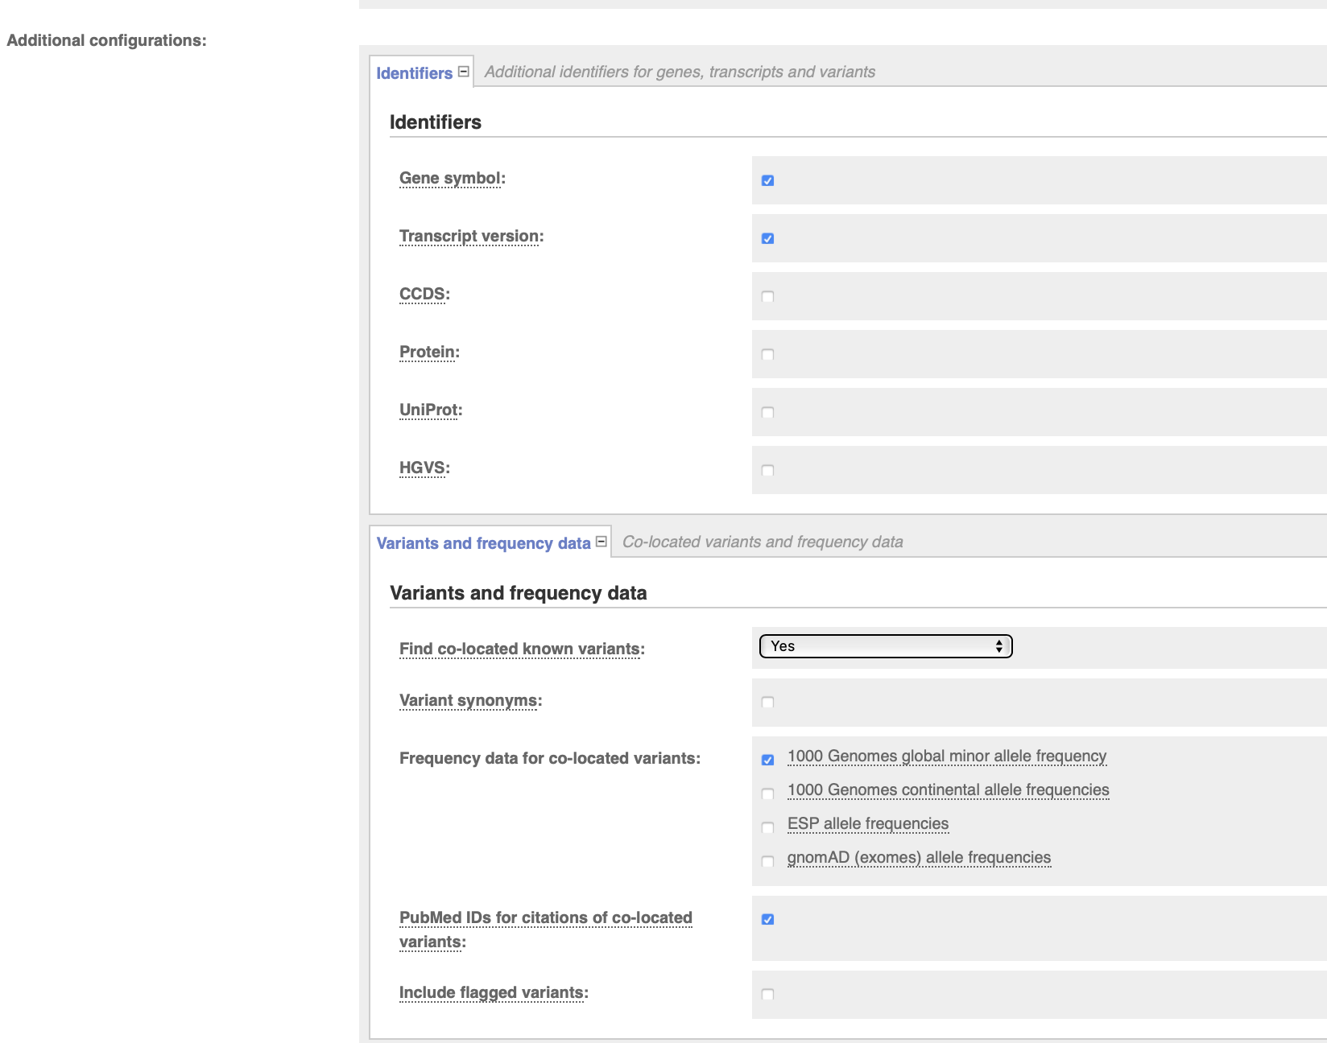
VEP
Additional options:
More transcript identifiers
Allele frequency and publication data

Slide 19
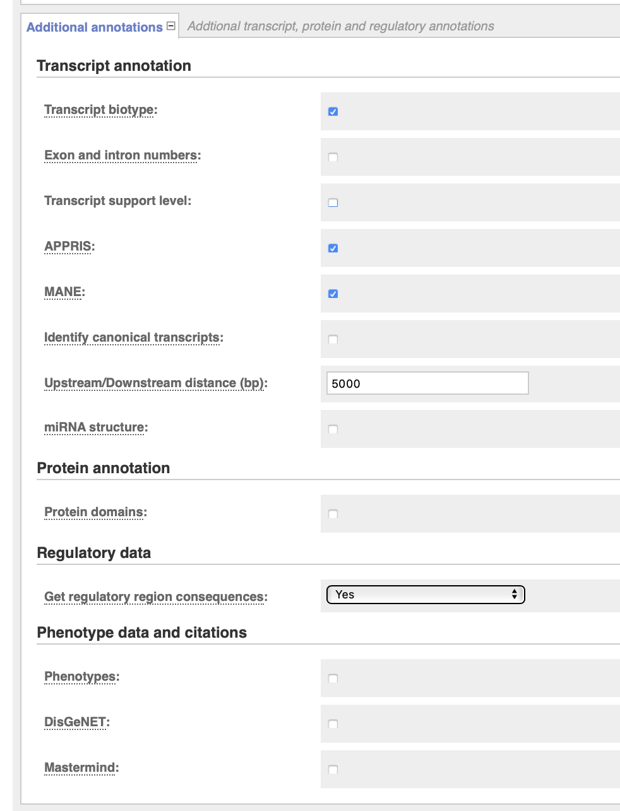
VEP
Additional options
Transcript/protein/regulatory annotation
Biotype = e.g., protein-coding, miRNA, pseudogene
Which intron/exon is variant in?
How close does a variant have to be in order to be ”mapped” to a transcript?
What protein domain is variant in?
Further regulatory consequences
Phenotype associations from several more databases

Slide 20
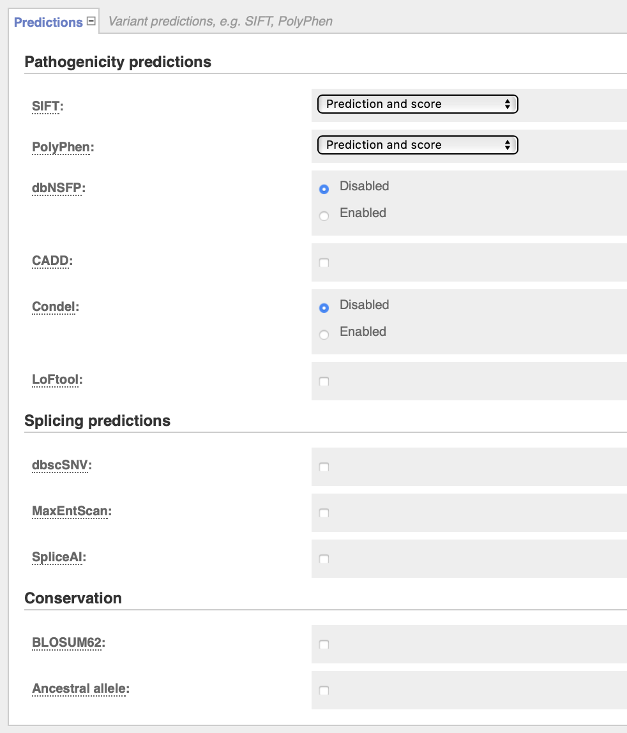
VEP
Additional options
SIFT/PolyPhen (scores for missense variants)
CADD (combined annotation score for deleteriousness)
Splicing/conservation info

Slide 21
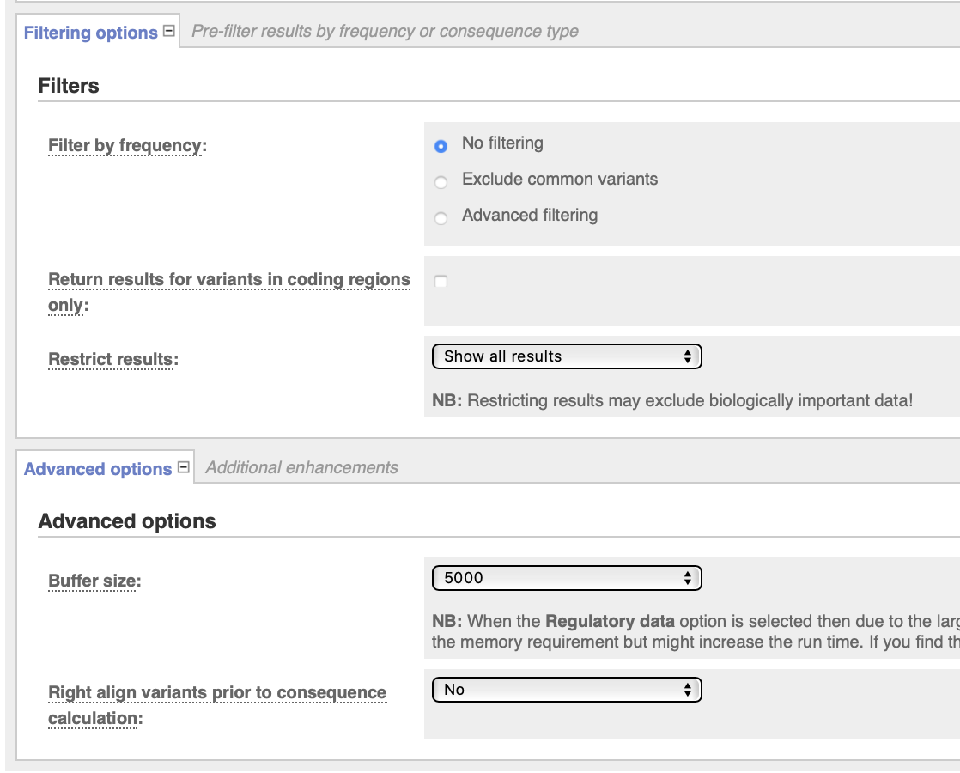
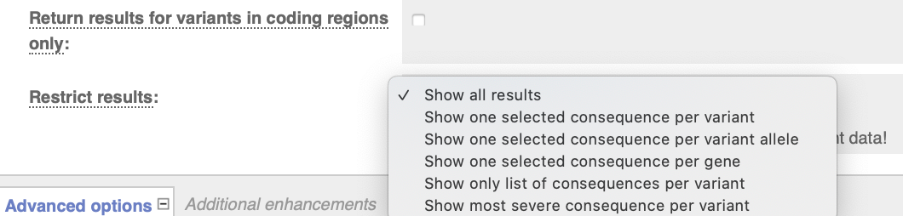
VEP
Additional options
Filtering by allele freq. (mainly in 1KG)
Select only certain consequences

Slide 22
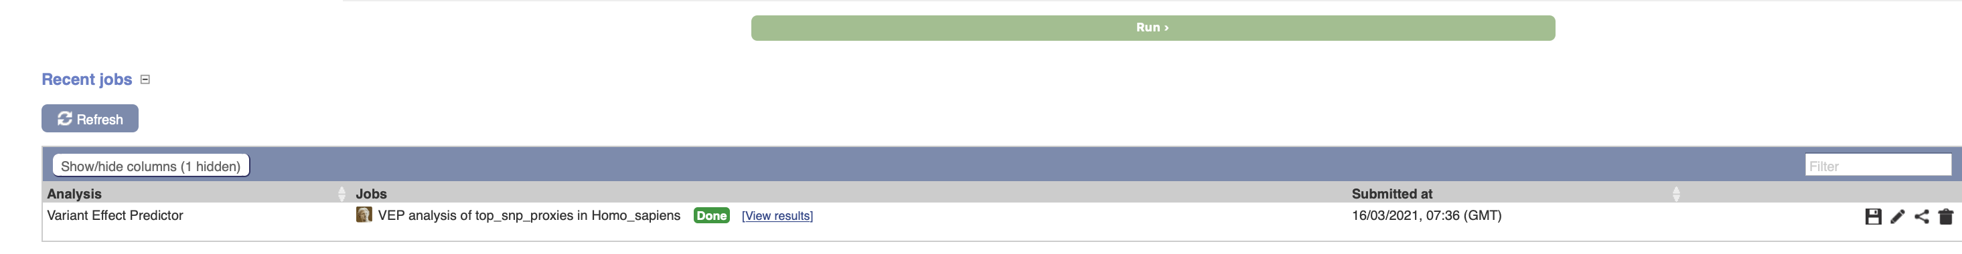
VEP
Click “Run”, wait, and then view the results. You can access results of multiple runs.

Slide 23
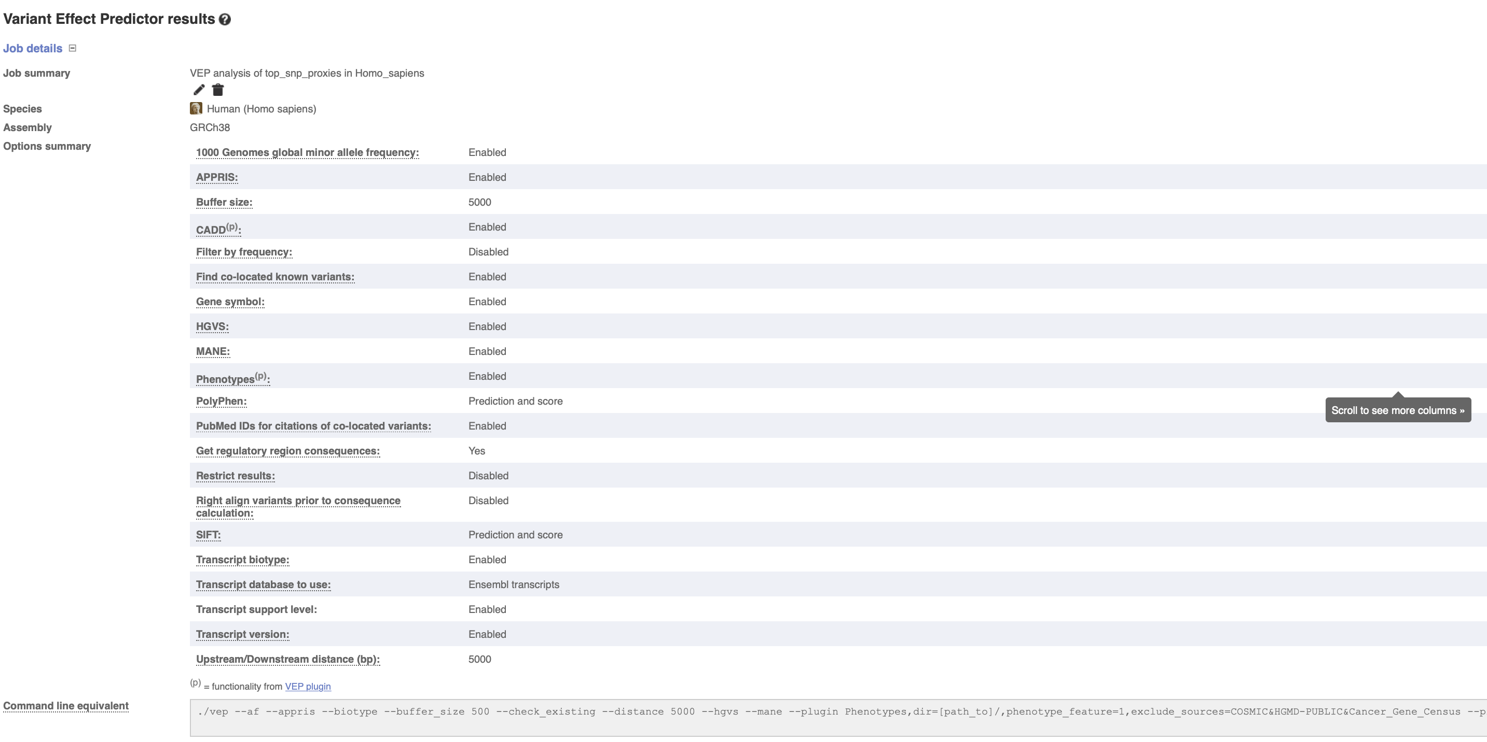
VEP
You can review the options you used for your run.
The command-line command is also provided for reproducing your annotation.

Slide 24
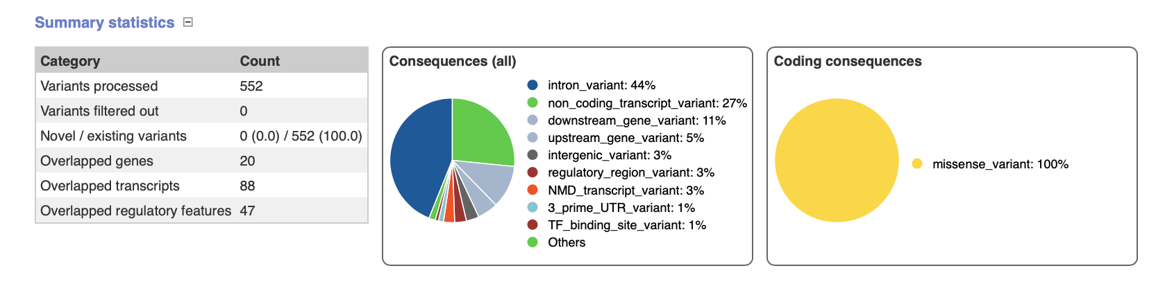
VEP
VEP gives a brief summary of the number of variants provided and their consequences.

Slide 25
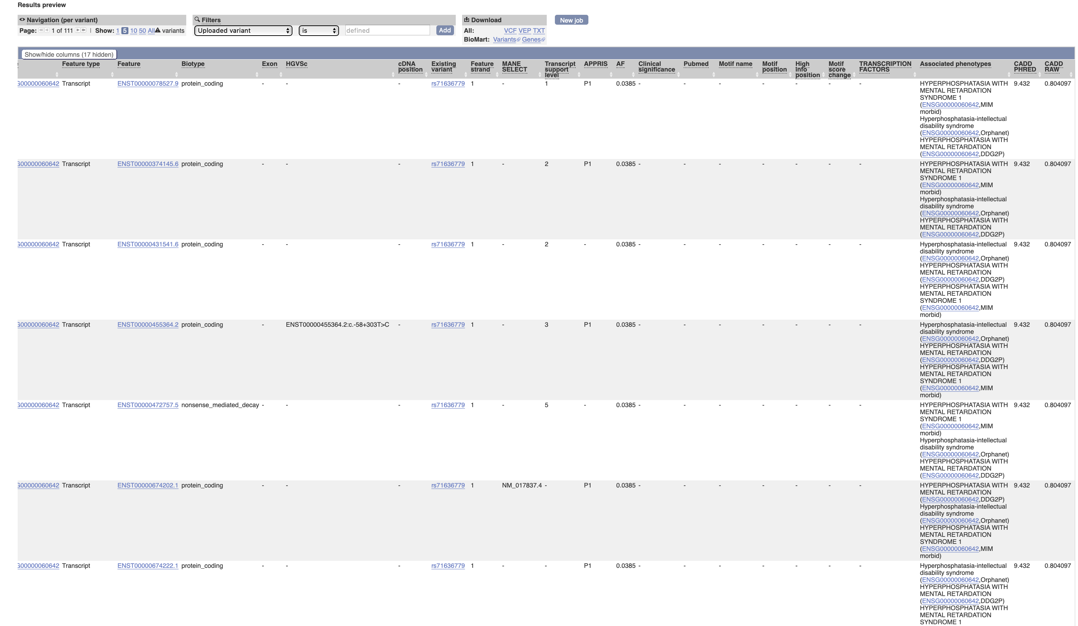
VEP
Results can be viewed in browser or downloaded as text/VCF.

Slide 26
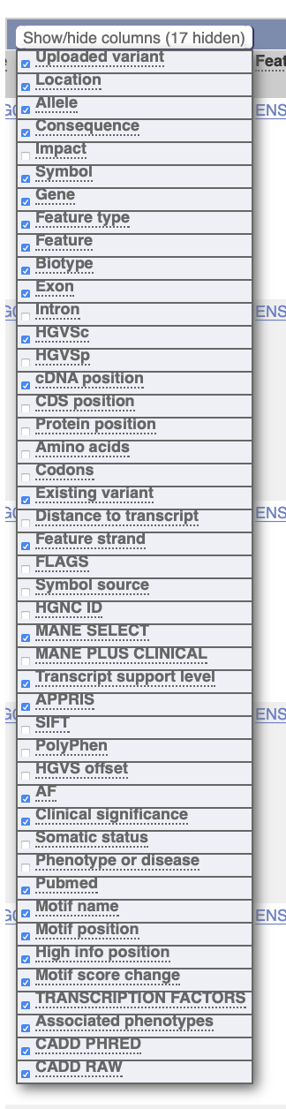
VEP
Format the table by selecting columns to show.

Slide 27
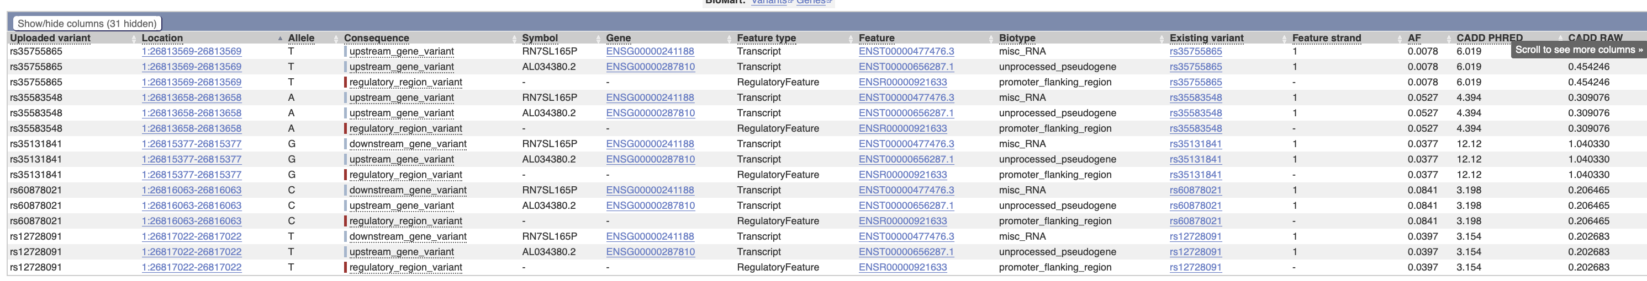
VEP

Slide 28
HaploReg
https://pubs.broadinstitute.org/mammals/haploreg/haploreg.php
Documentation https://pubs.broadinstitute.org/mammals/haploreg/documentation_v4.1.html
Publication https://academic.oup.com/nar/article/40/D1/D930/2903522
Background on chromatin states https://www.ncbi.nlm.nih.gov/pmc/articles/PMC3088773/

Slide 29
HaploReg
Usage
Input formats
Comma-delimited list of rsIDs or a single region (e.g., chr3:123456:234567)
Text file with one rsID per line
OR use the R package HaploR
Parameters
LD threshold
Population for calculating LD (AFR, AMR, ASN, EUR)
Source for epigenomes
Conservation algorithm
Gene set (GENCODE or RefSeq)
Display/output options

Slide 30
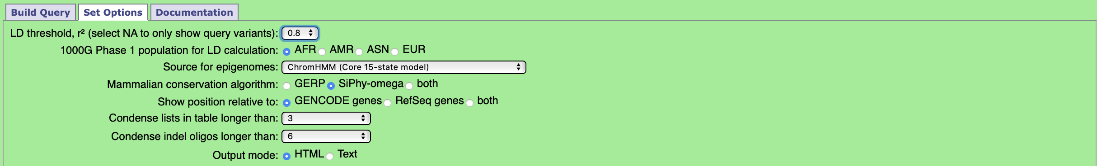
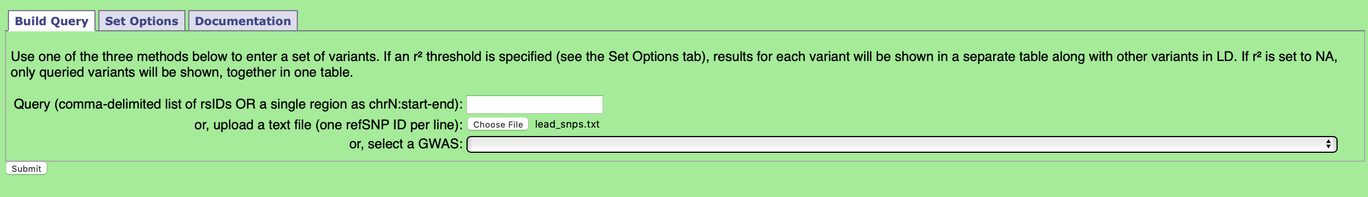
HaploReg
Set parameters
Select input file and submit (I supplied a list of 10 “lead SNPs” from a fake GWAS)
Notes:
rs26540
Rs13107325
Rs921919
Rs13107325
Rs2256609
Rs3749748
Rs72801474
rs2502465

Slide 31
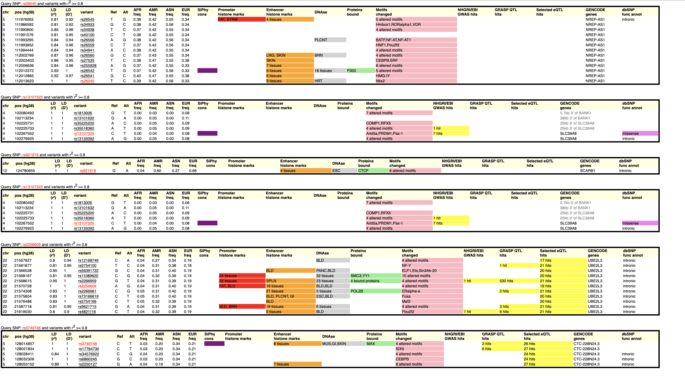
HaploReg
Output: a table for each SNP
SNP1
SNP2
SNP3 Let’s look at these two →
→
…
….

Slide 32
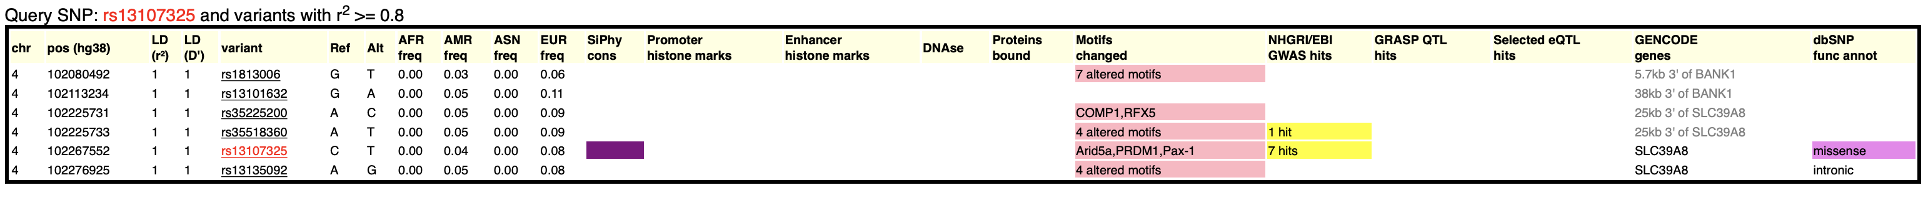
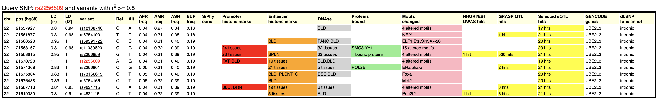
HaploReg
Table for rs13107325 and its LD “friends”
The queried SNP is a missense variant in SLC39A8 with 7 GWAS associations; it alters several motifs and is “constrained.” Nearby genes are given for some of LD “friends.”
Table for rs2256609 and its LD “friends”
The queried SNP is in an intron of UBE2L3. Numerous eQTL associations; histone marks suggest it lies in an enhancer for numerous tissues; DNAse sensitivity peaks for “BLD” tissue. LD “friends” also show protein binding annotation. In the next slide, zoom in on rs2256609 by clicking the variant name.

Slide 33
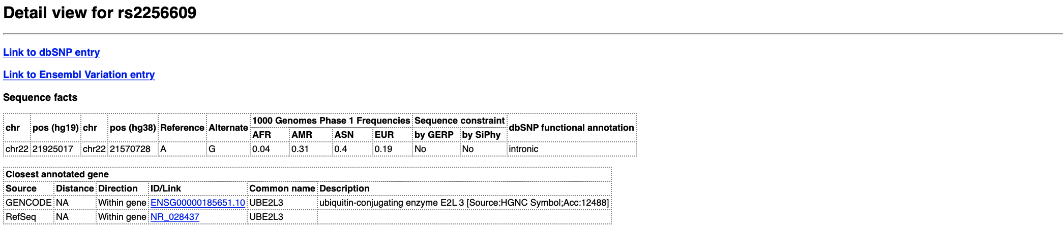
HaploReg
Detail for rs2256609

Slide 34
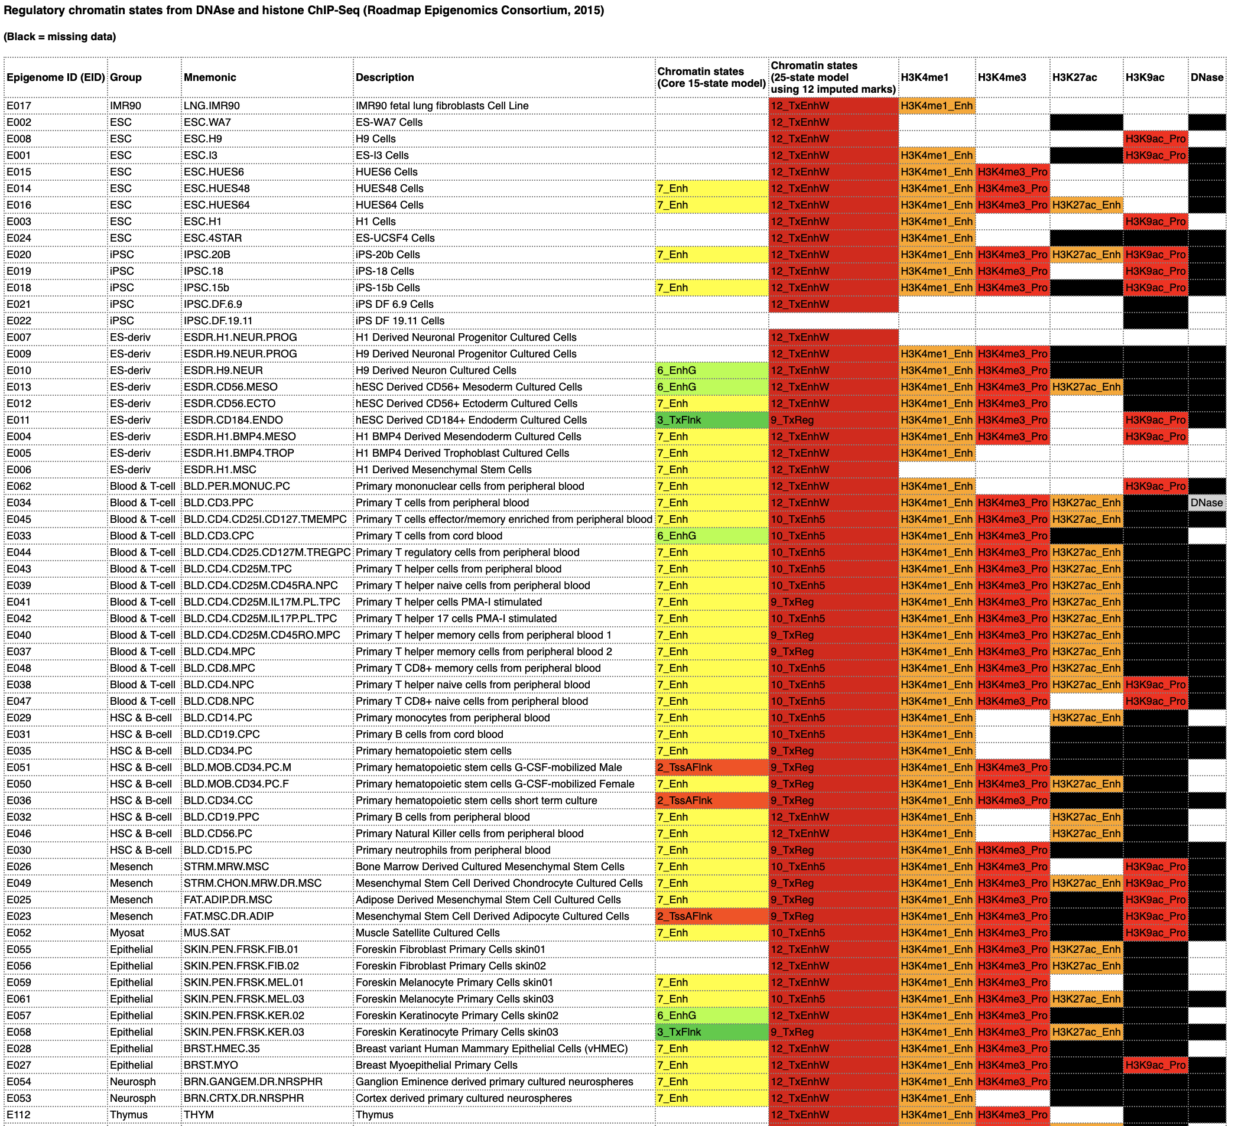
HaploReg
Detail for rs2256609
Histone marks for each cell/tissue type
Columns 1-4: cell/tissue identifier
Columns 5-6: chromatin state codes (see next slide)
Columns 7-11: specific chromatin marks and DNAse sensitivity

Slide 35
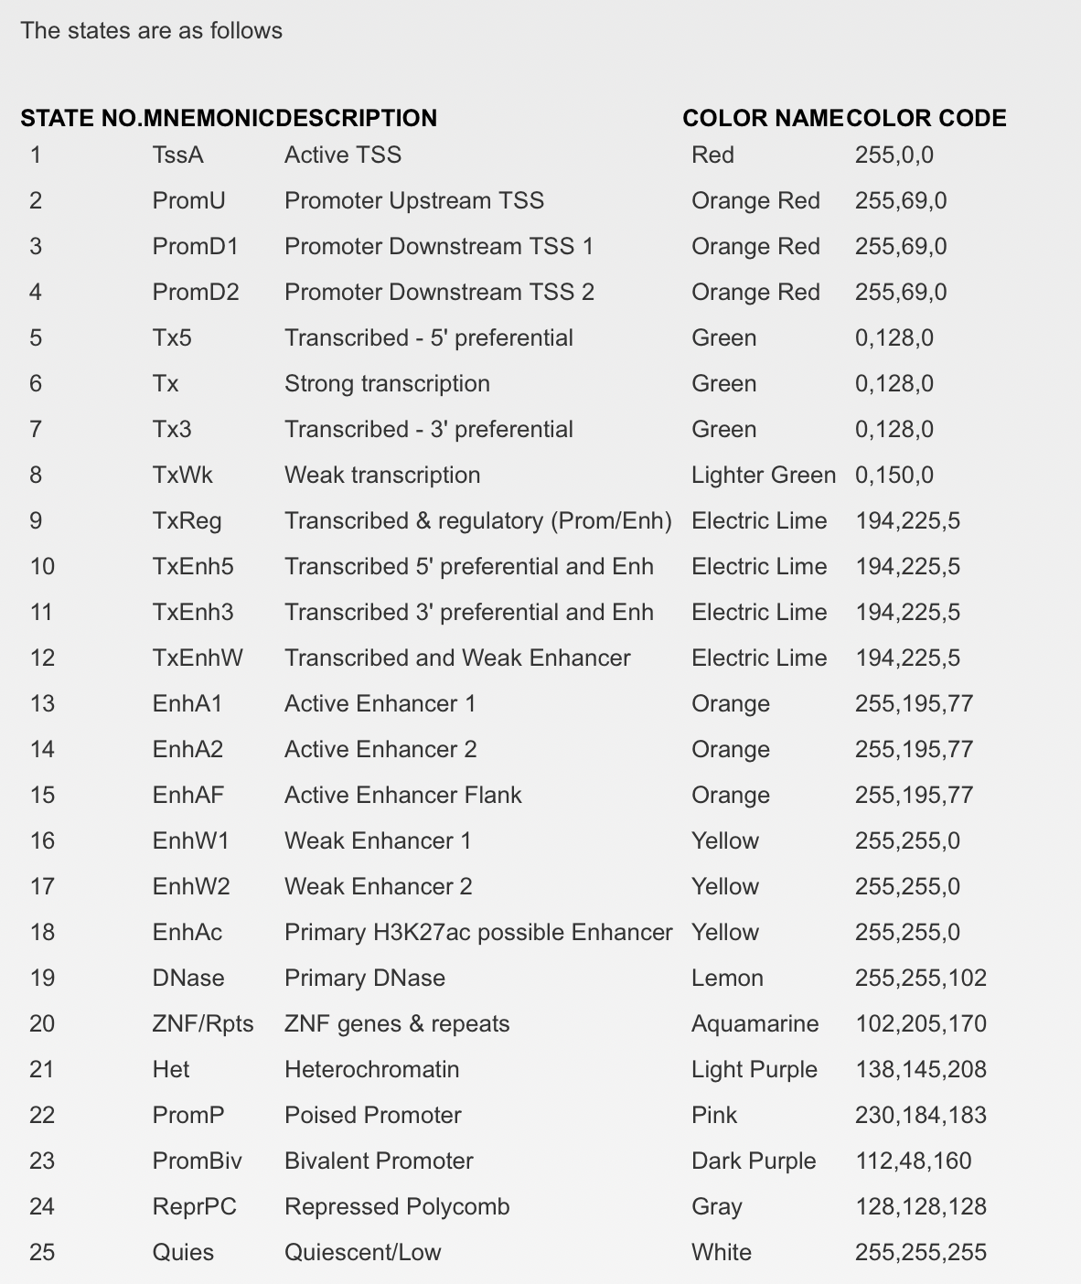
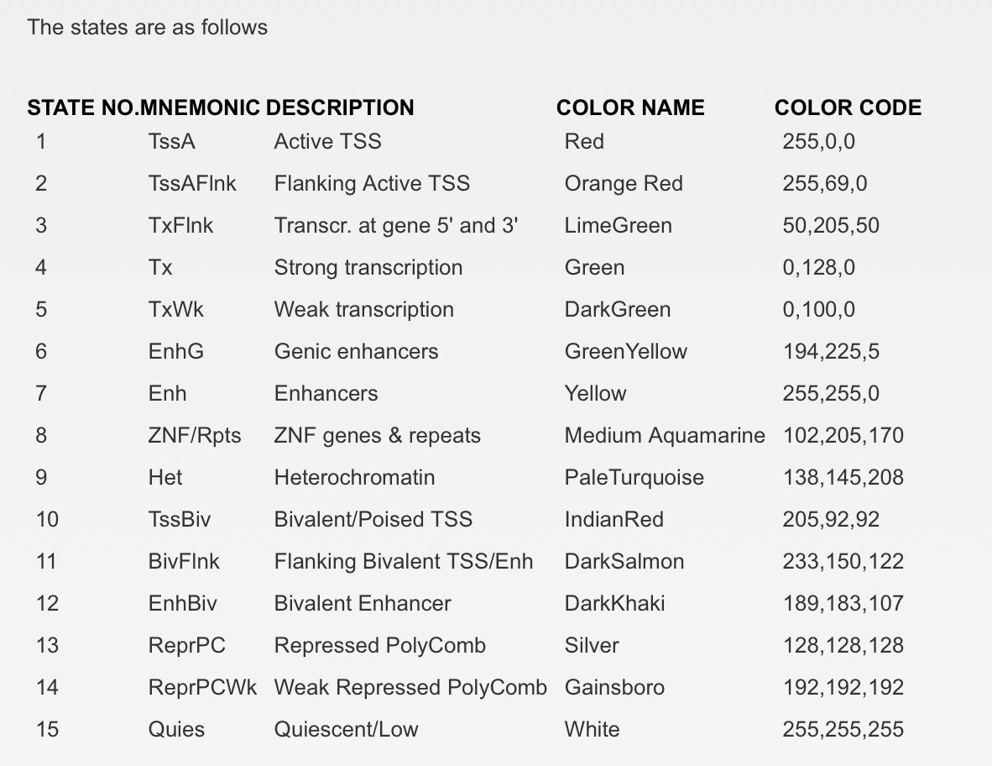
HaploReg
Key to coloring/abbreviations in the chromatin states columns

Slide 36
RegulomeDB
https://regulomedb.org
Usage
Input formats (text box only)
Enter rsIDs line by line
Or enter coordinate ranges line by line (chr6:12345:23456)
OR use the R package HaploR
No parameters
Documentation: https://regulomedb.org/regulome-help/
Reference: https://www.ncbi.nlm.nih.gov/pmc/articles/PMC3431494/

Slide 37
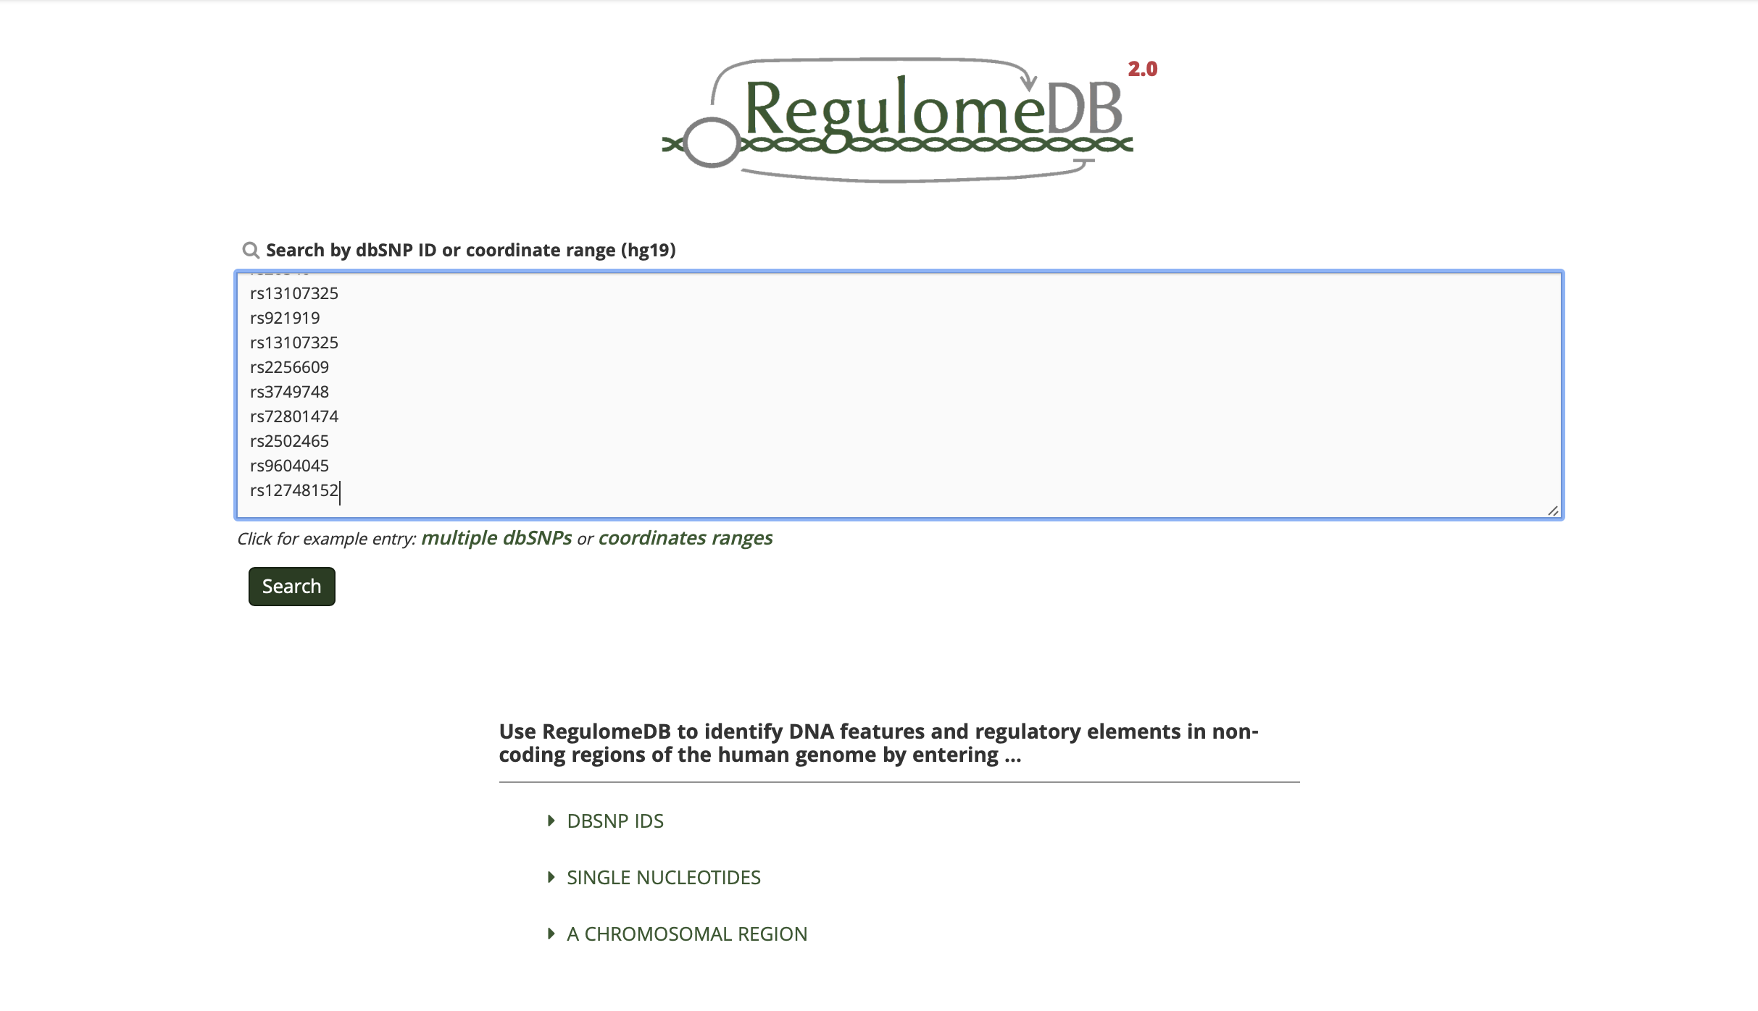
RegulomeDB
Searching a list of SNPs

Slide 38
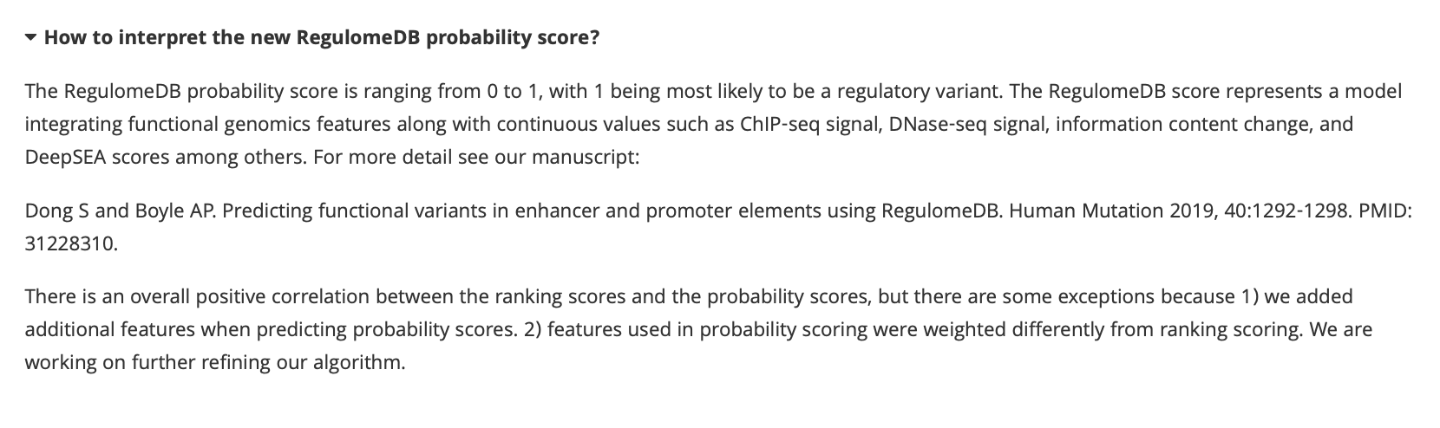
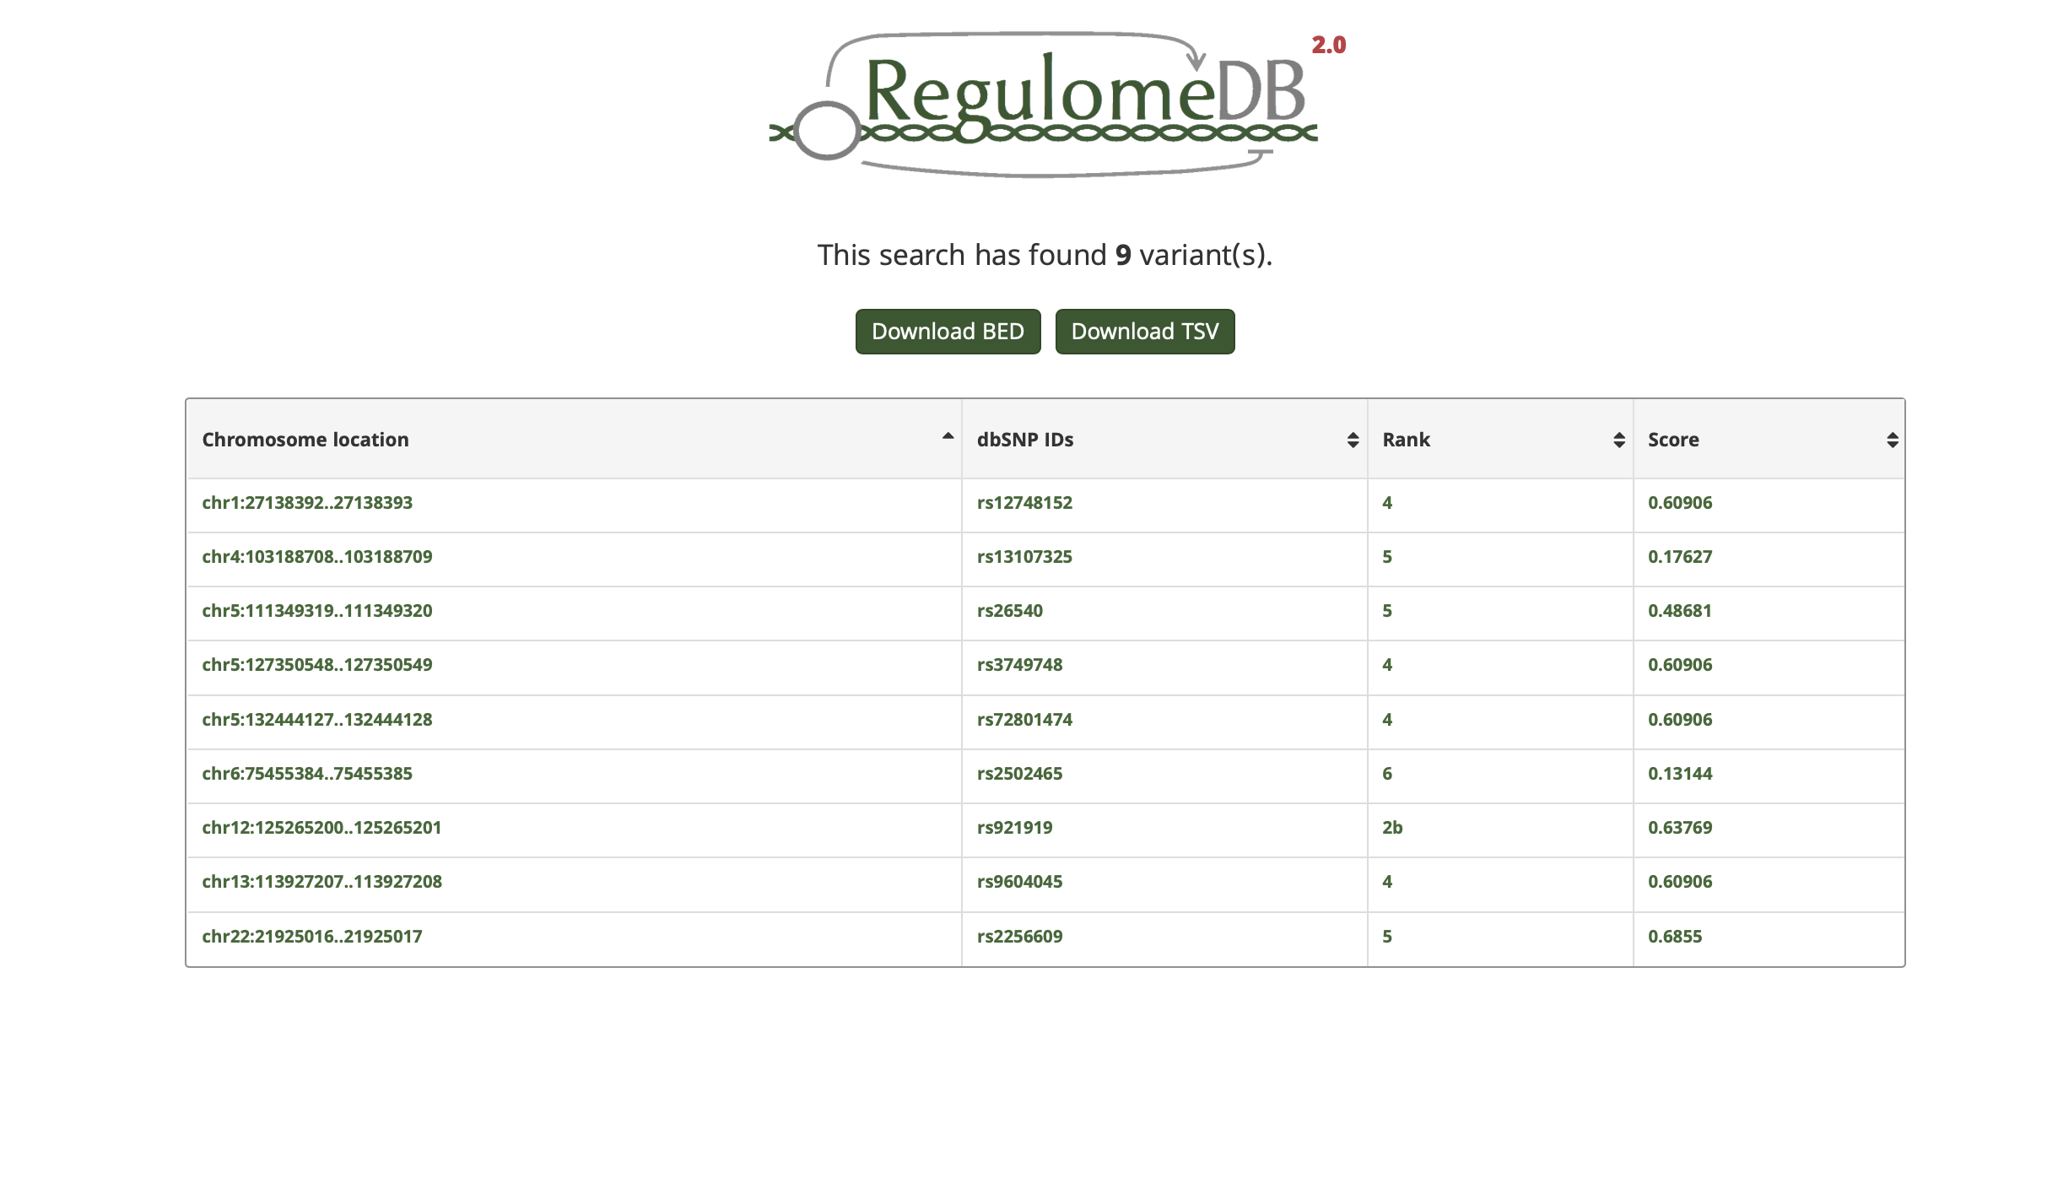
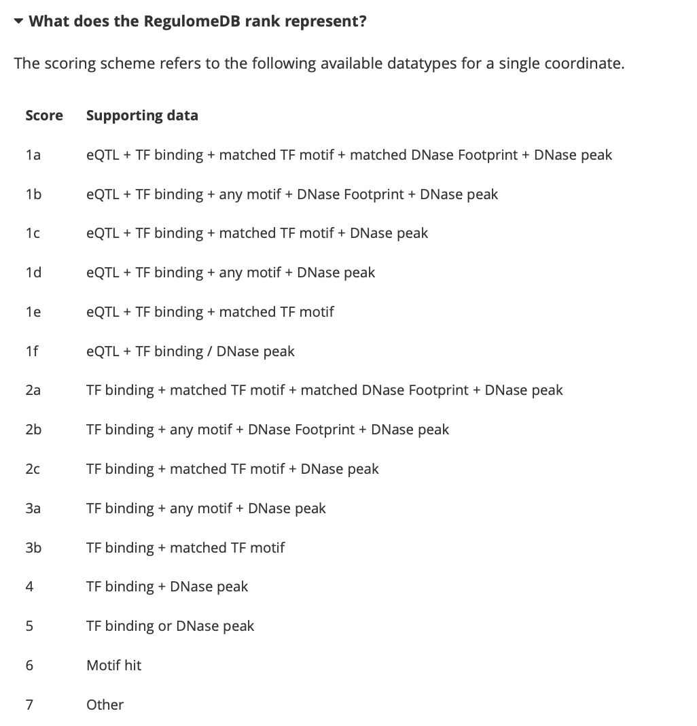
RegulomeDB
Output – click on a SNP
Let’s click on rs921919 (lowest “rank”)

Slide 39
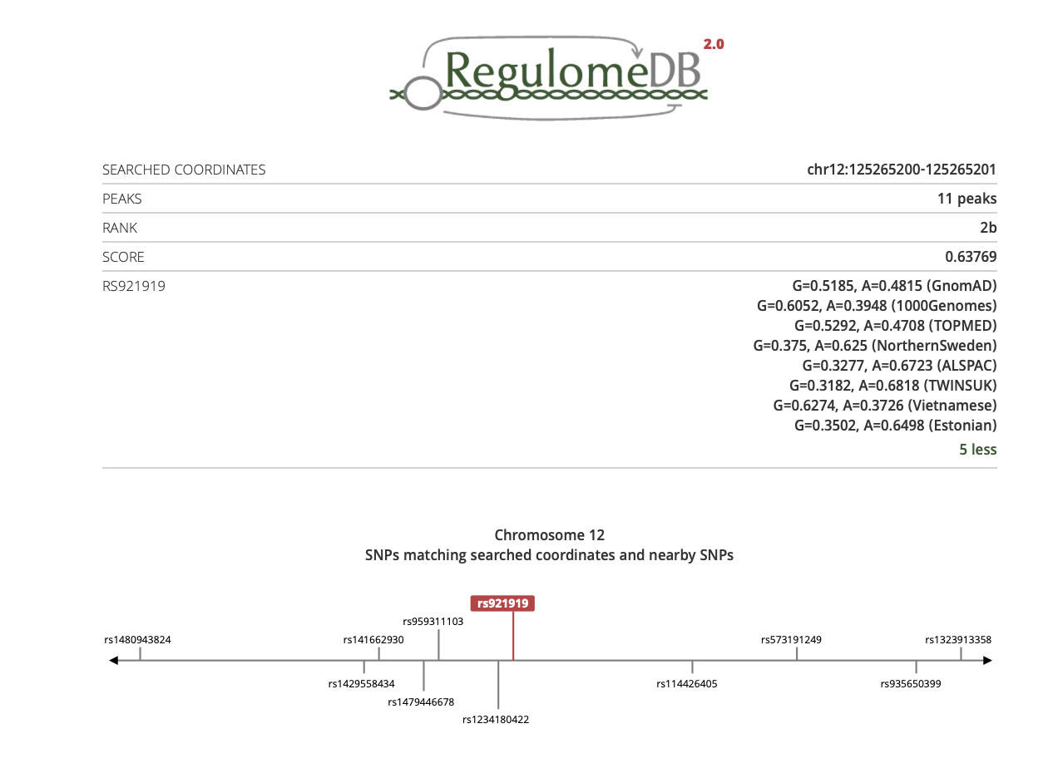
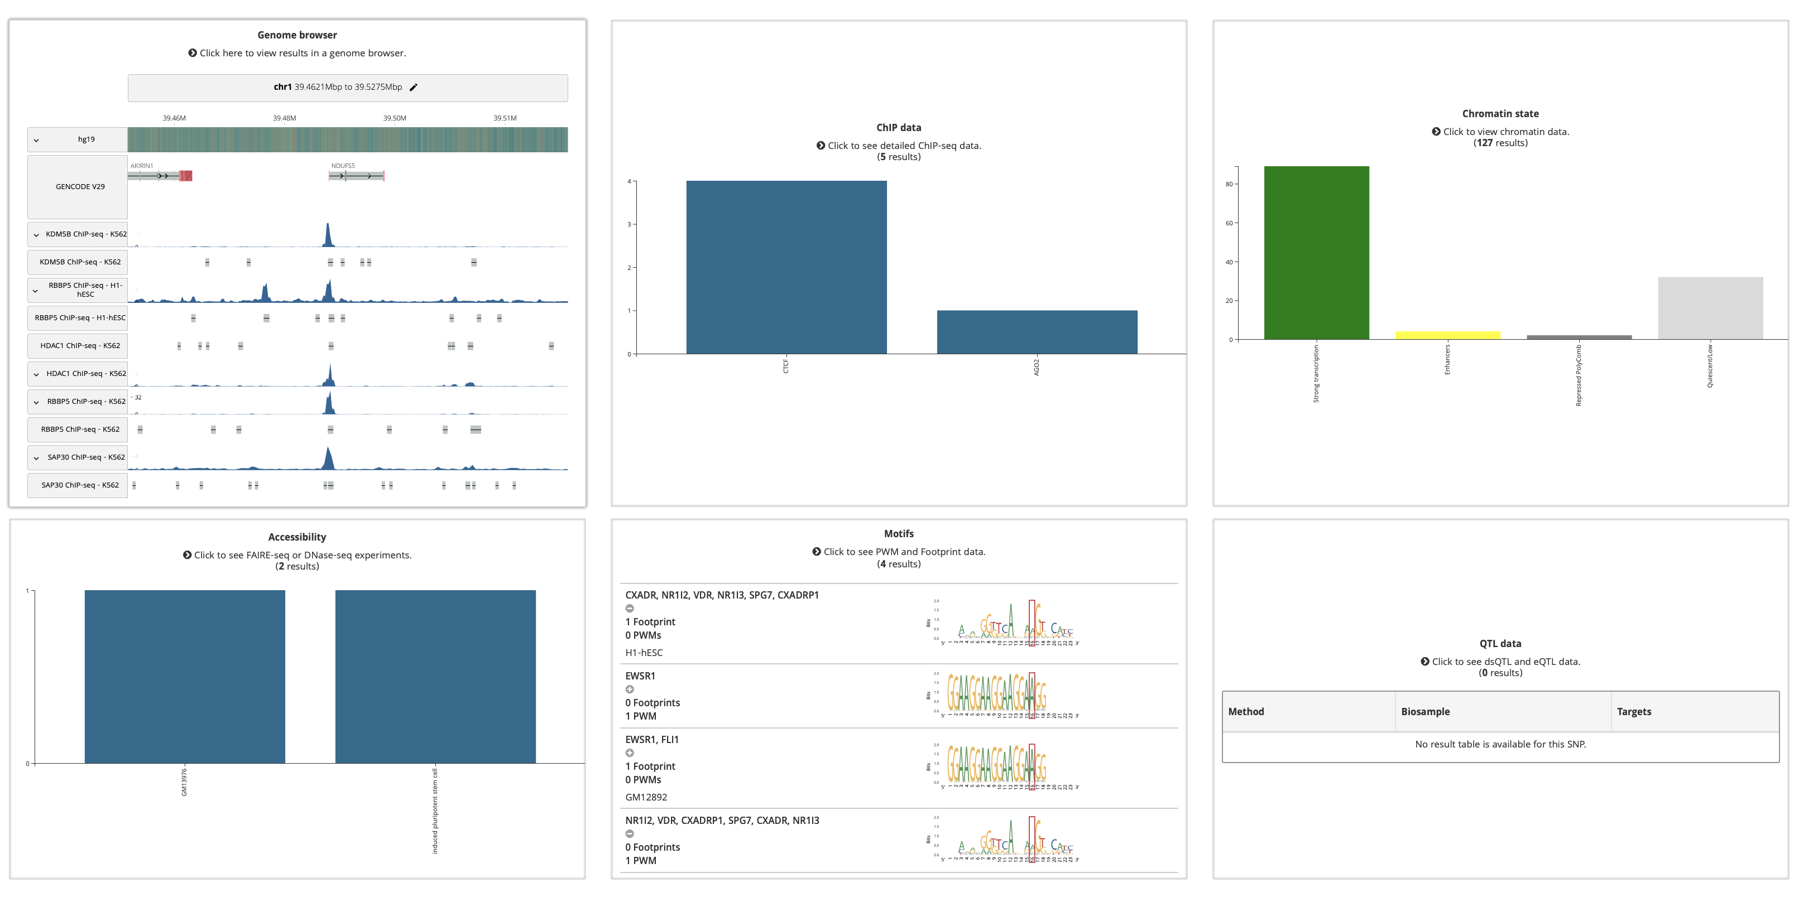
RegulomeDB
Detail for rs921919

Slide 40
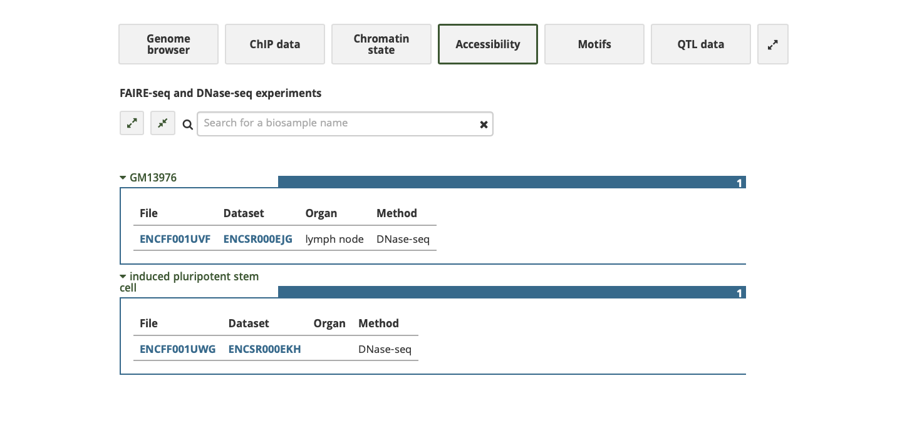
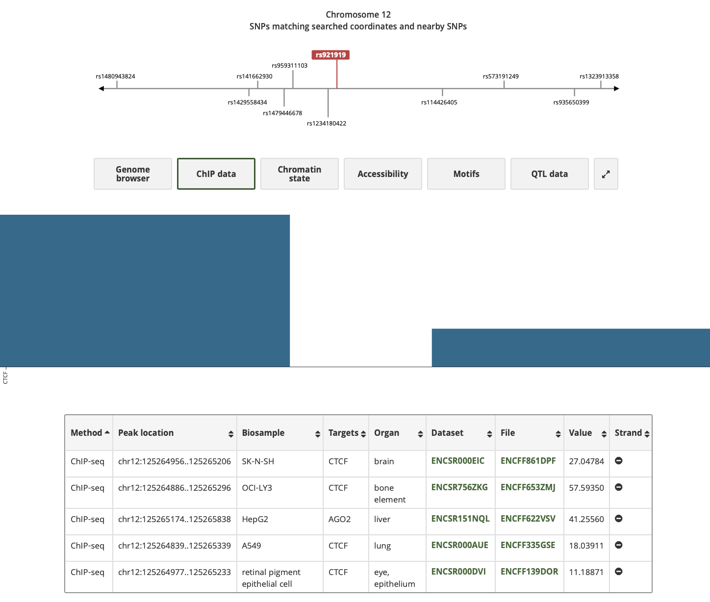
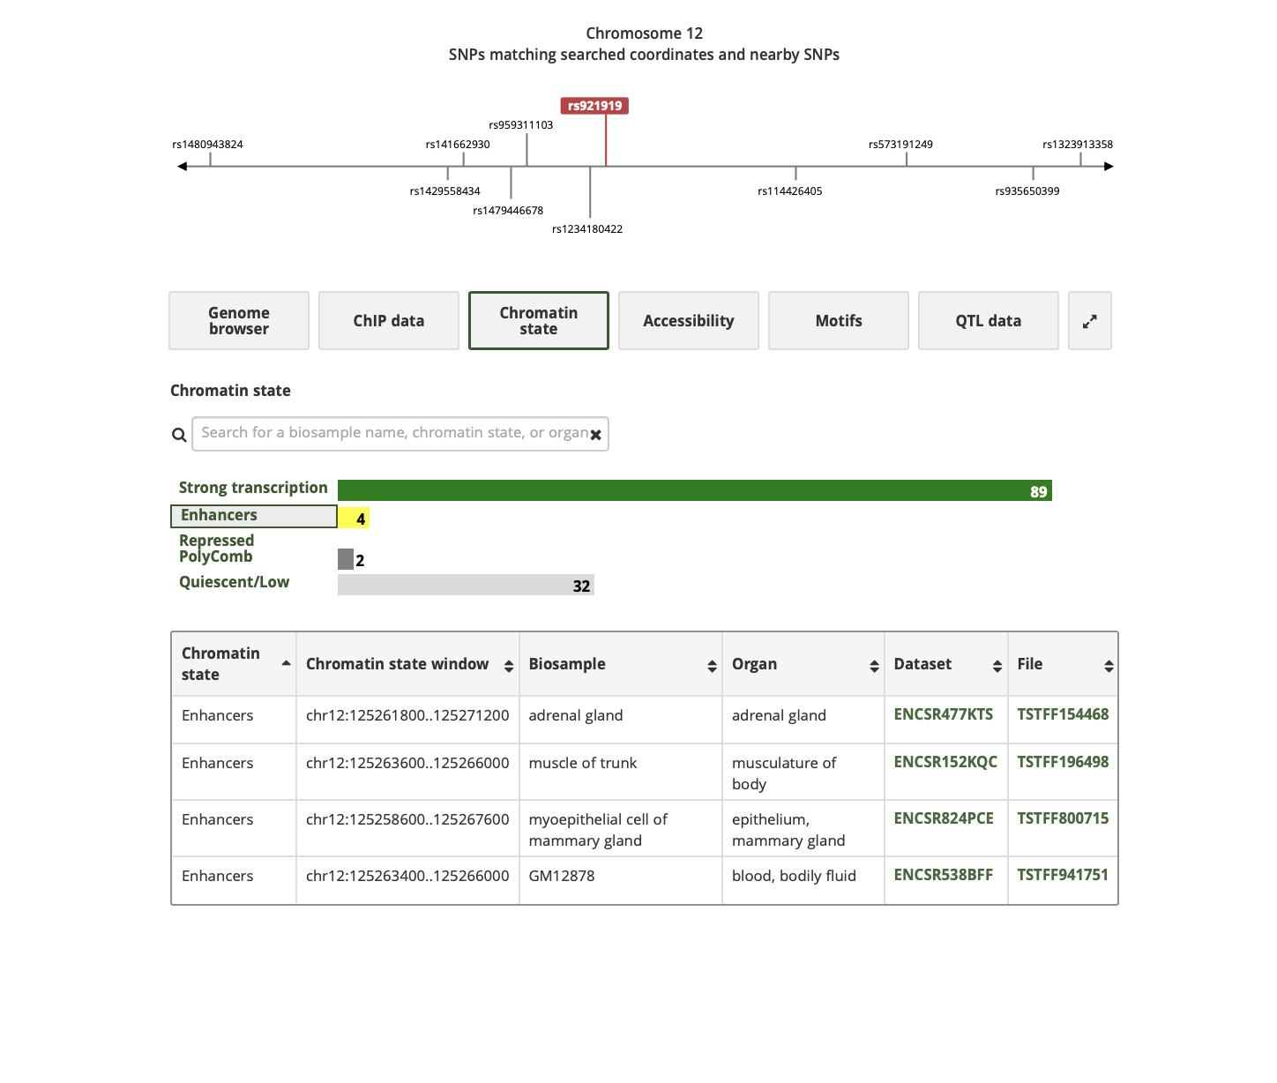
RegulomeDB
Detail for rs921919

Slide 41
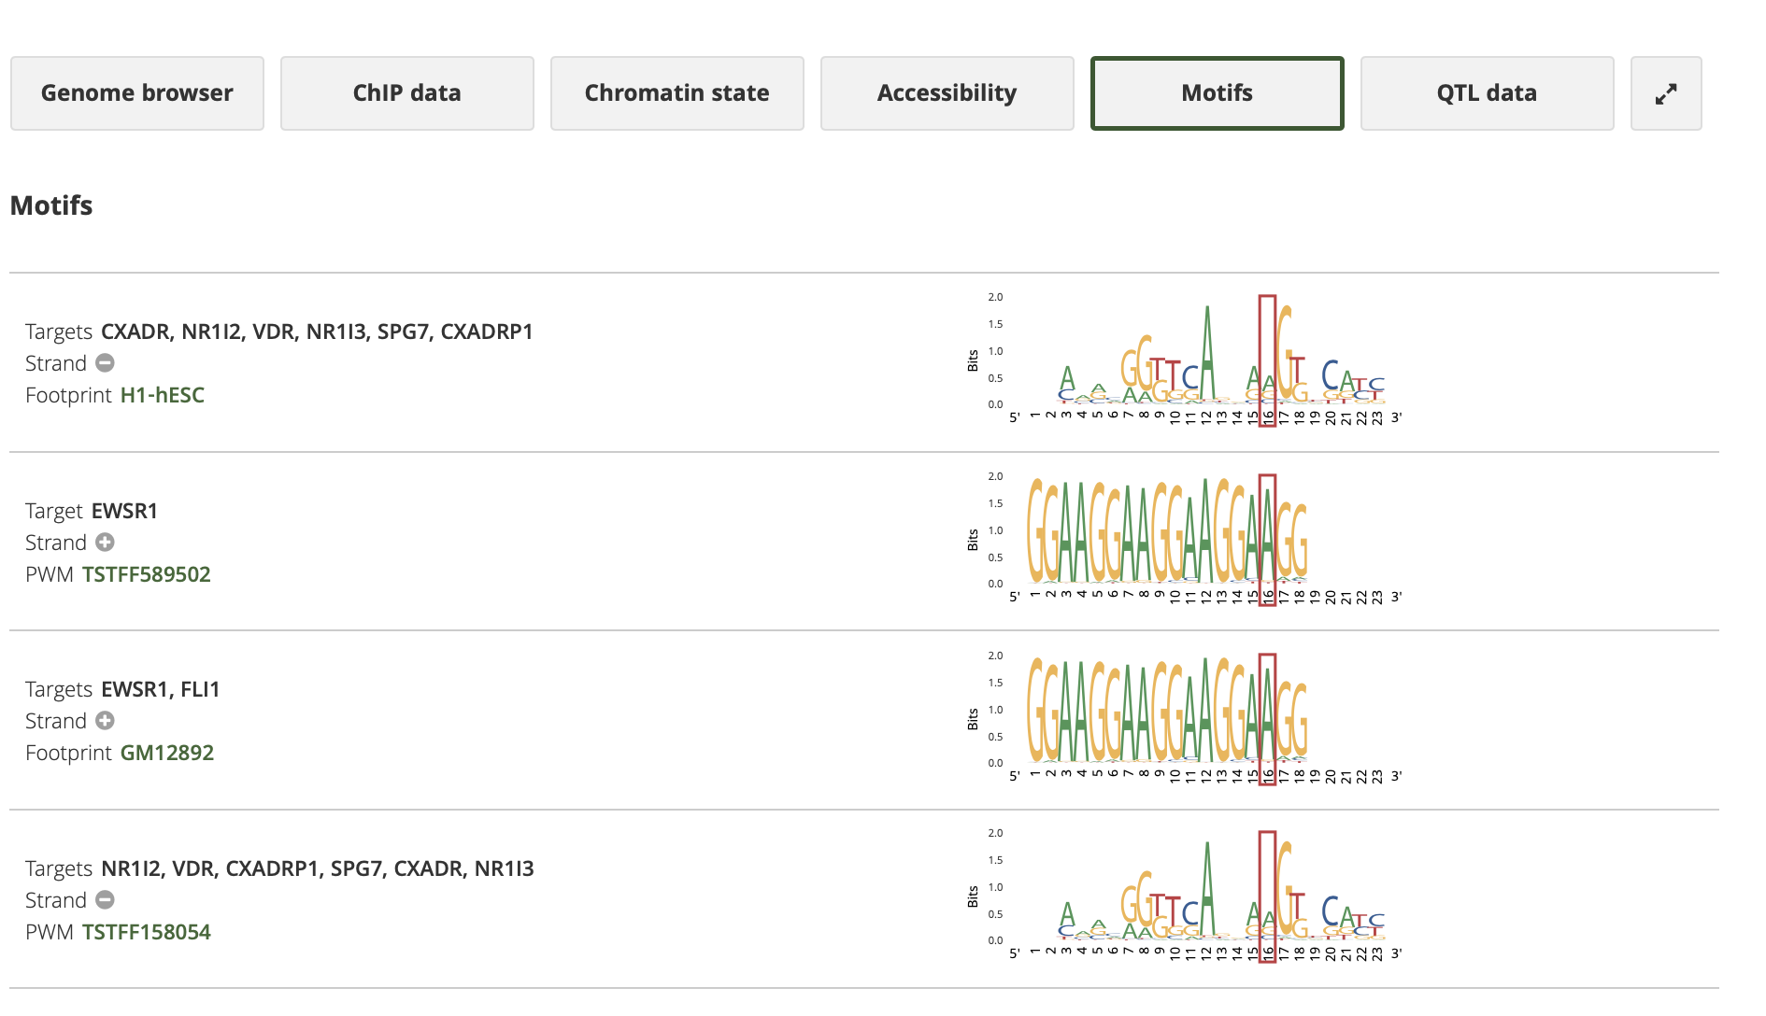
RegulomeDB
Detail for rs921919

Slide 42
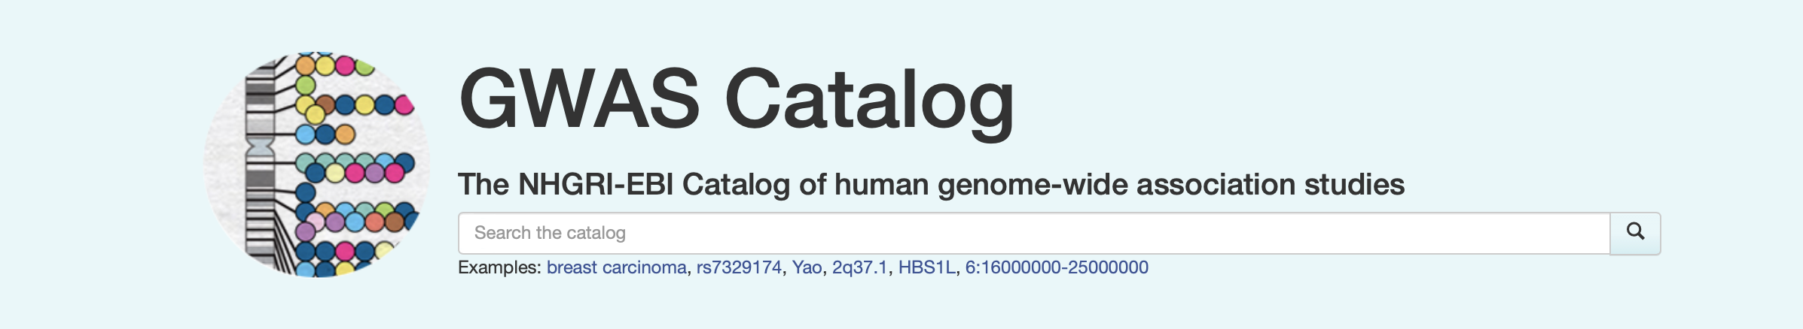
GWAS Catalog
https://www.ebi.ac.uk/gwas/
Input for “direct access”
SNP/variant
Region
Gene
Phenotype
Author/study
Some forms of output
Variant
Region
Gene
Trait
Publication

Slide 43
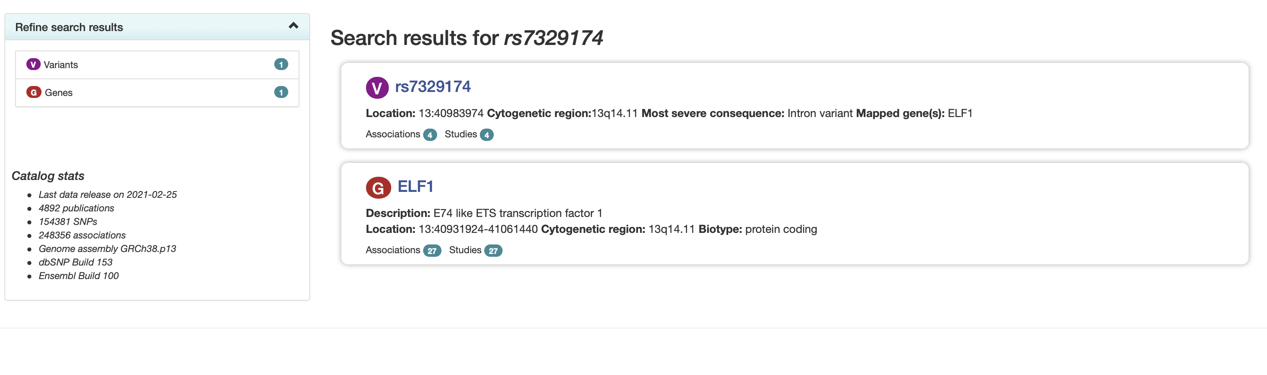
GWAS Catalog
Examples of variant and gene “tags”

Slide 44
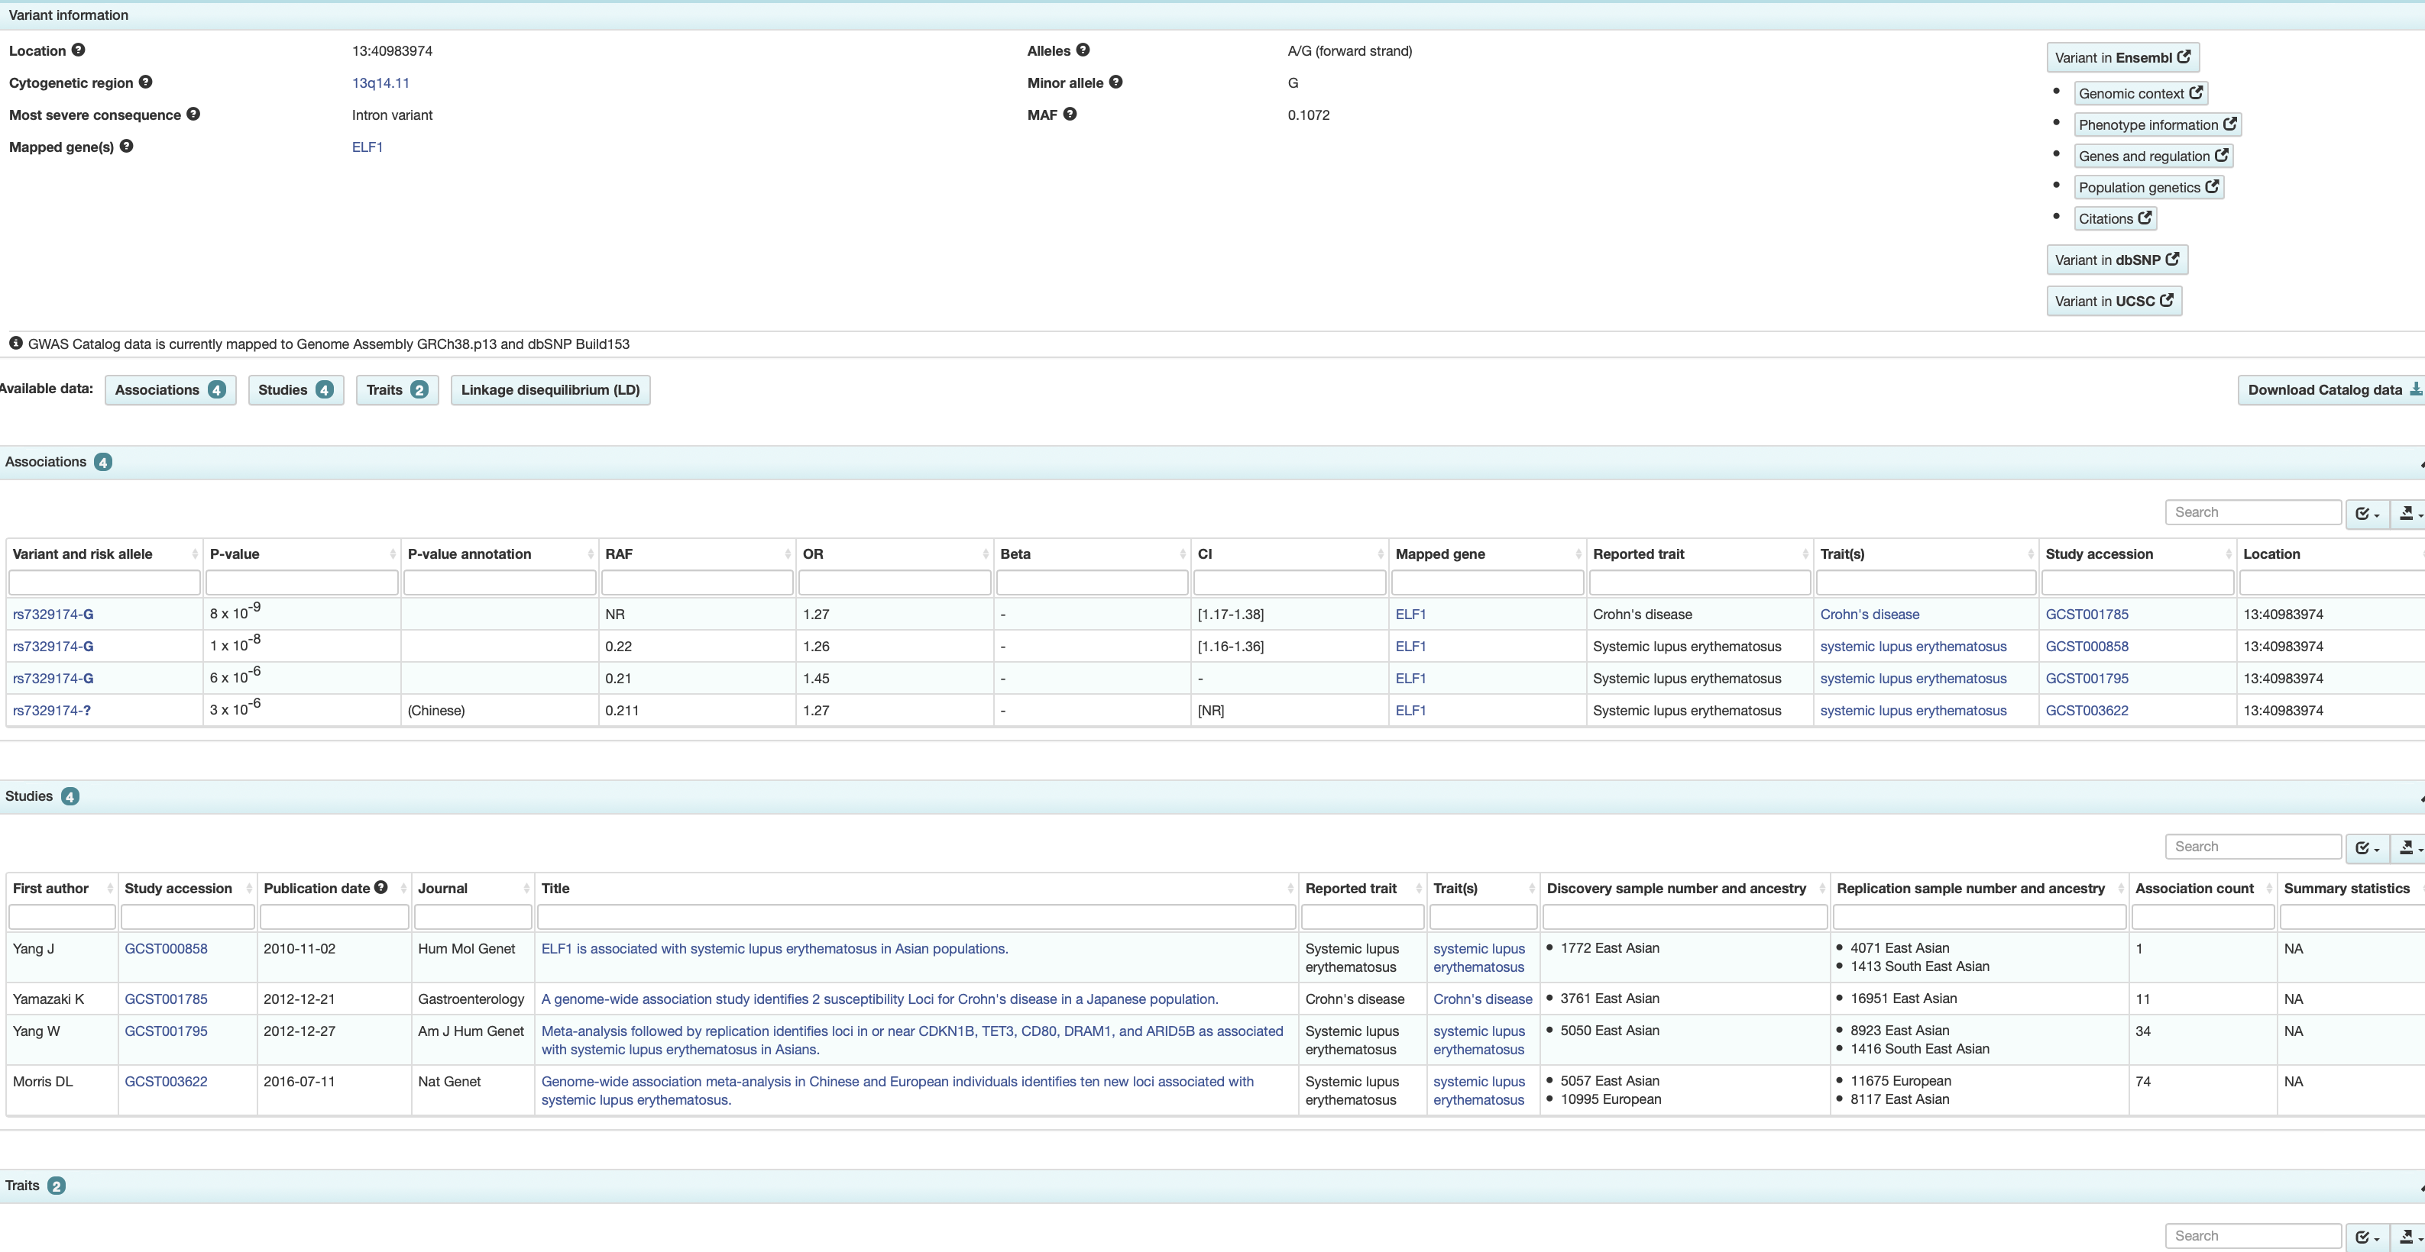
GWAS Catalog
Variant → Tables of associations, studies, and traits

Slide 45
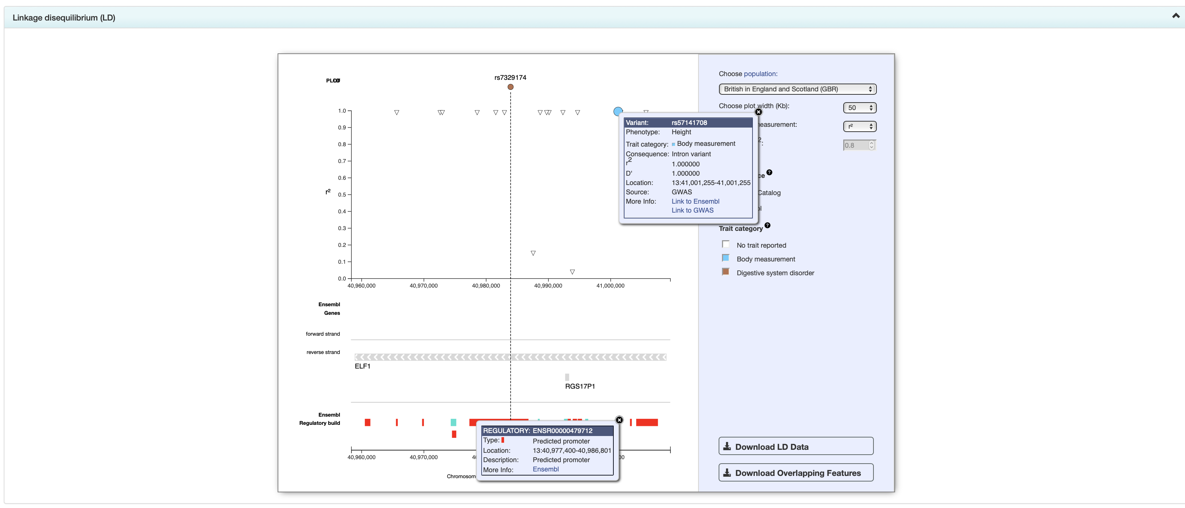
GWAS Catalog
Variant → LD plot with some tracks

Slide 46
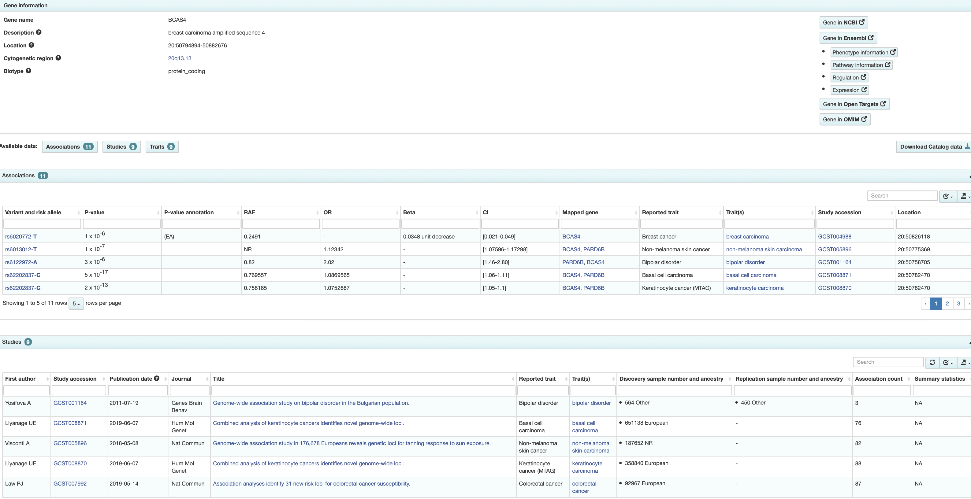
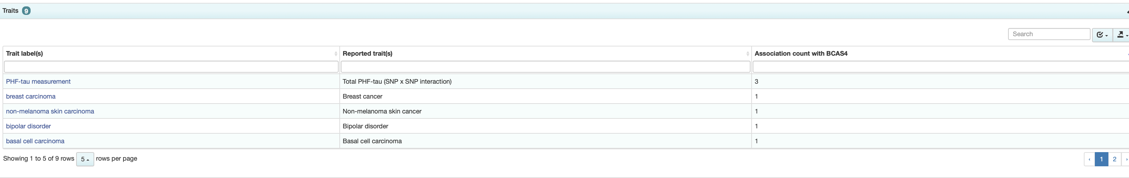
GWAS Catalog
Gene → Tables of associations, studies, and traits

Slide 47

GWAS Catalog
Region → Tables of associations, studies, and traits

Slide 48

GWAS Catalog
Trait → Tables of associations and studies

Slide 49

GWAS Catalog
Trait → interactive cross-study Manhattan plot

Slide 50

GWAS Catalog
Study → tables of associations, related studies

Slide 51
Lab
Either individually or in small groups, use the list of 10 lead SNPs from a GWAS and the supplied tutorial/exercise code (on Canvas).
Tutorial
Use LDlinkR to find LD proxies
Write out the list of rsIDs
Upload to VEP and annotate them
Use HaploR to query HaploReg and RegulomeDB for the 10 SNPs, using various parameters
Play with LDlinkR a little more
Exercise: trying to replicate/verify some claims from a COVID-19 GWAS

